Slide 1
Feature extraction and classification
January 2025
Andrea Corrado

Slide 2
Outline
Feature extraction
Envelope features
Template matching features
Short time Fourier transformation features
Classification
Knowledge based classifier: recap
Improved Knowledge based classifier
Feature correlation analysis
Tree classifier: whole set of features and optimal subset of features
SVM classifier: whole set of features and optimal subset of features
MLR classifier: whole set of features and optimal subset of features
Best model evaluation
Conclusions

Slide 3
Outline
Feature extraction
Envelope features
Template matching features
Short time Fourier transformation features
Classification
Knowledge based classifier: recap
Improved Knowledge based classifier
Feature correlation analysis
Tree classifier: whole set of features and optimal subset of features
SVM classifier: whole set of features and optimal subset of features
MLR classifier: whole set of features and optimal subset of features
Best model evaluation
Conclusions

Slide 4
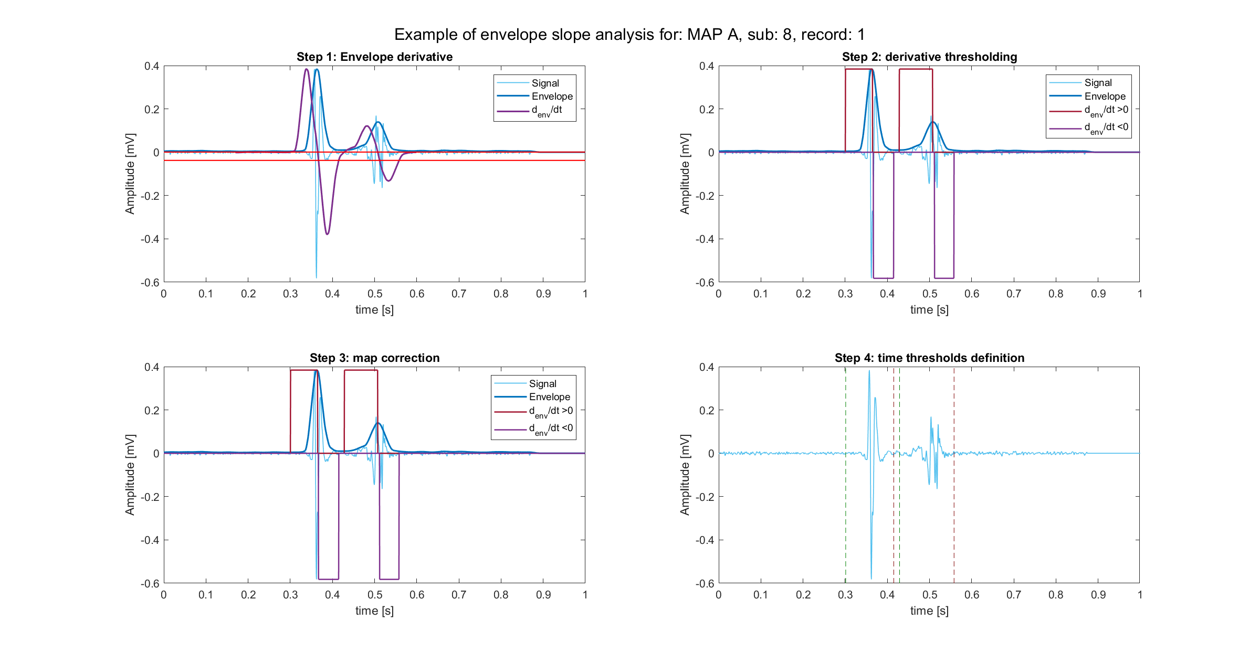
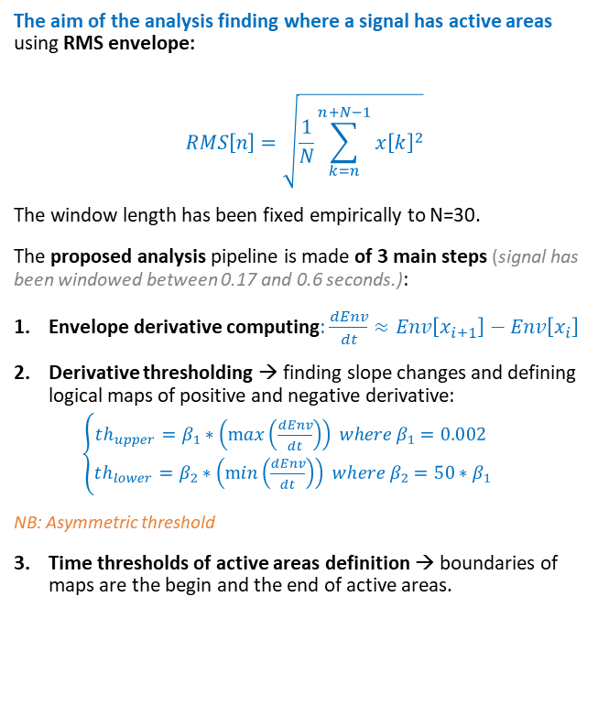
Envelope definition and peak recognition
The aim of the analysis finding where a signal has active areas using RMS envelope:
$$RMS\left[n\right]=\sqrt{\frac{1}{N}\sum_{k=n}^{n+N−1}{x{\left[k\right]}^{2}}}$$
The window length has been fixed empirically to N=30.
The proposed analysis pipeline is made of 3 main steps (signal has been windowed between 0.17 and 0.6 seconds.):
Envelope derivative computing: $\frac{dEnv}{dt}≈Env\left[x_{i+1}\right]−Env\left[x_{i}\right]$
Derivative thresholding → finding slope changes and defining logical maps of positive and negative derivative:
$\left\{\begin{aligned}th_{upper}=β_{1}∗\left(\max\left(\frac{dEnv}{dt}\right)\right) where β_{1}=0.002 \\ th_{lower}=β_{2}∗\left(\min\left(\frac{dEnv}{dt}\right)\right) where β_{2}=50∗β_{1}\end{aligned}\right.$
NB: Asymmetric threshold
Time thresholds of active areas definition → boundaries of maps are the begin and the end of active areas.

Slide 5
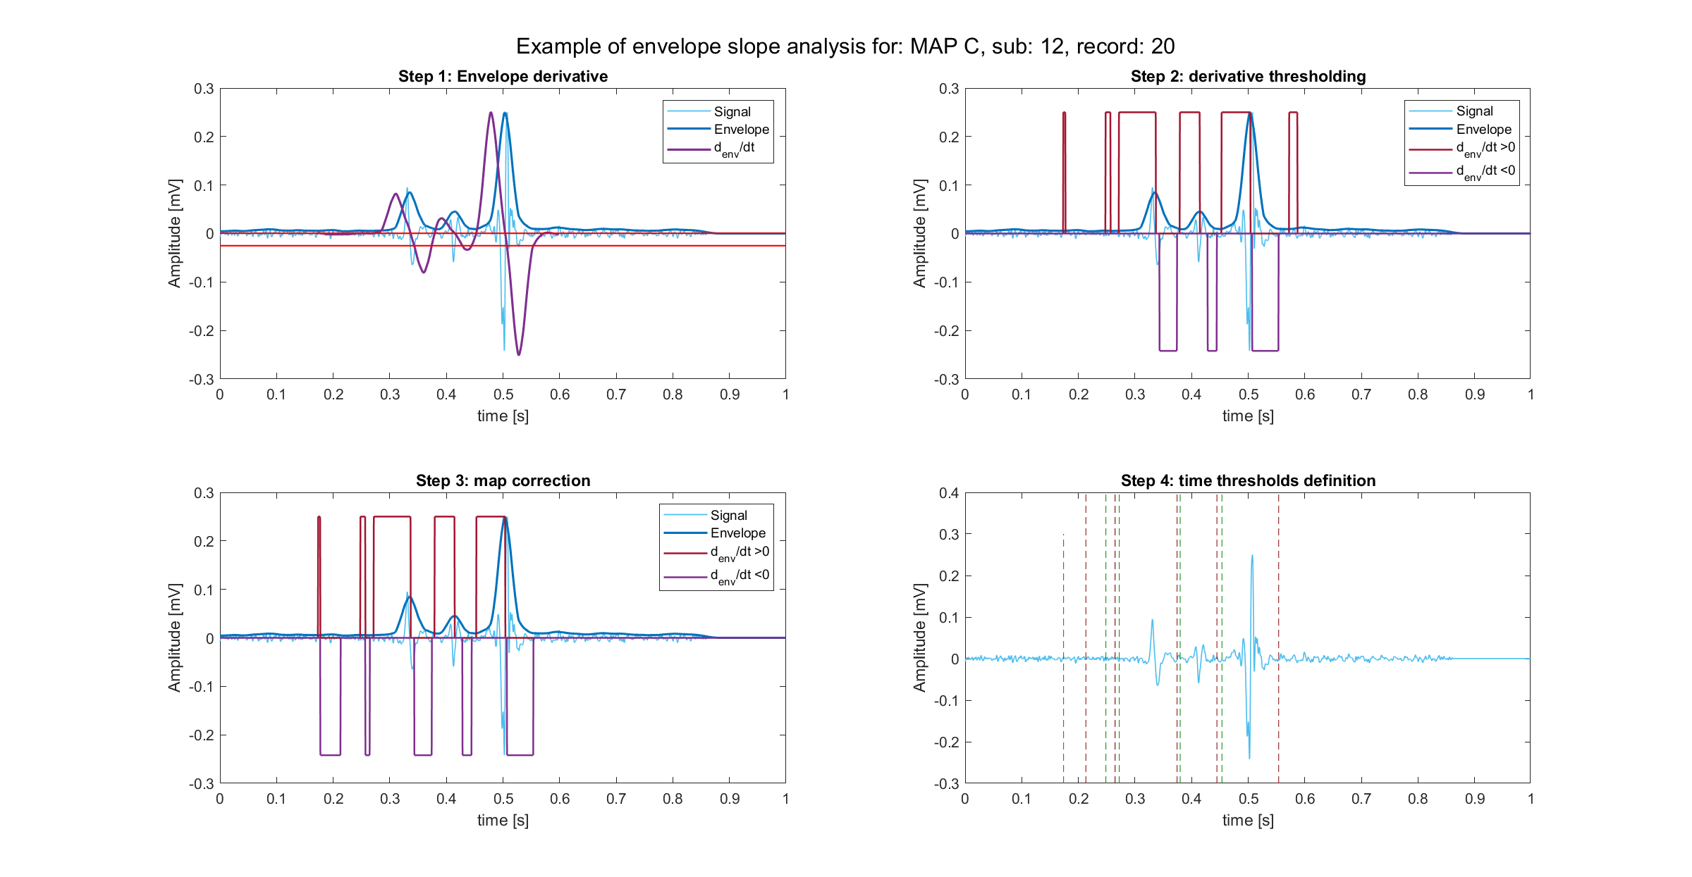
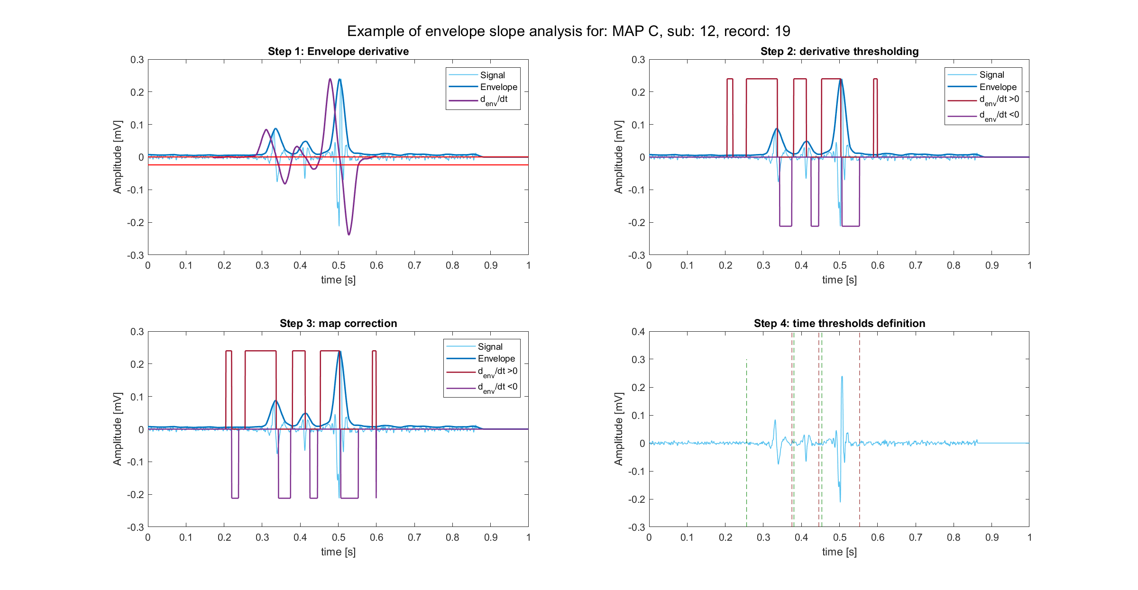
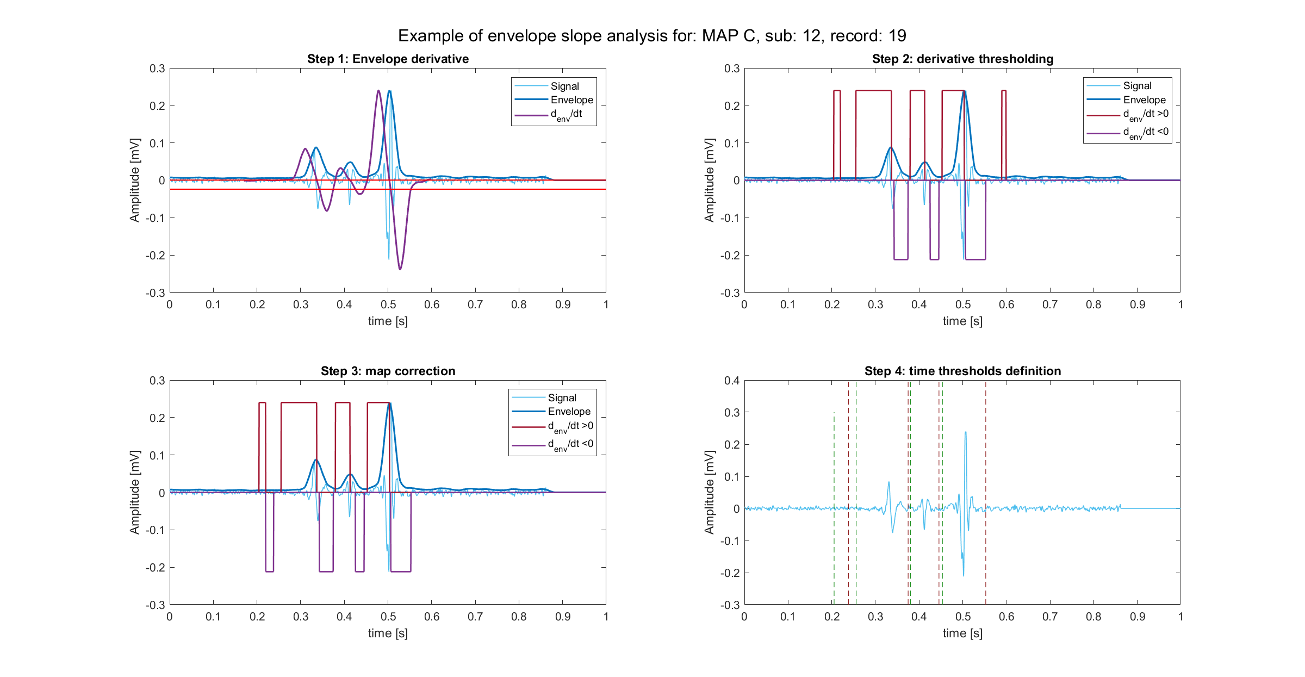
The over-detecting problem
This pipeline has a peculiarity: active areas are found in superabundance. In fact:
high sensibility of the upper threshold → even noise could be detected as peak → even noise can be seen as “active area” → “the higher, the better”.
A decisional rule is necessary.
True active areas are the ones associated to peaks higher than K=2.5 times the standard deviation of the signal.
After time thresholds cleaning

Slide 6
Active area analysis: entire set of features
Starting from active areas definition the following features have been computed:
Number of active area detected
Signal and envelope peaks absolute values
In order of magnitude: Dominant, Subdominant, Minor peak value and time (3 features from Rov signal + 3 features from envelope signal)
In order of occurrence: First, Second, Third peak value and time (3 features from Rov signal + 3 features from envelope signal)
Duration of active signal
Silent phase within signal duration
Ratios between single features
Subdominant to major,
Minor to subdominant
Atrial to ventricular peak ratio
Atrial to ventricular peak time ratio
Number of active areas on duration ratio
Silent phase on duration ratio
Number of peaks on duration ratio

Slide 7
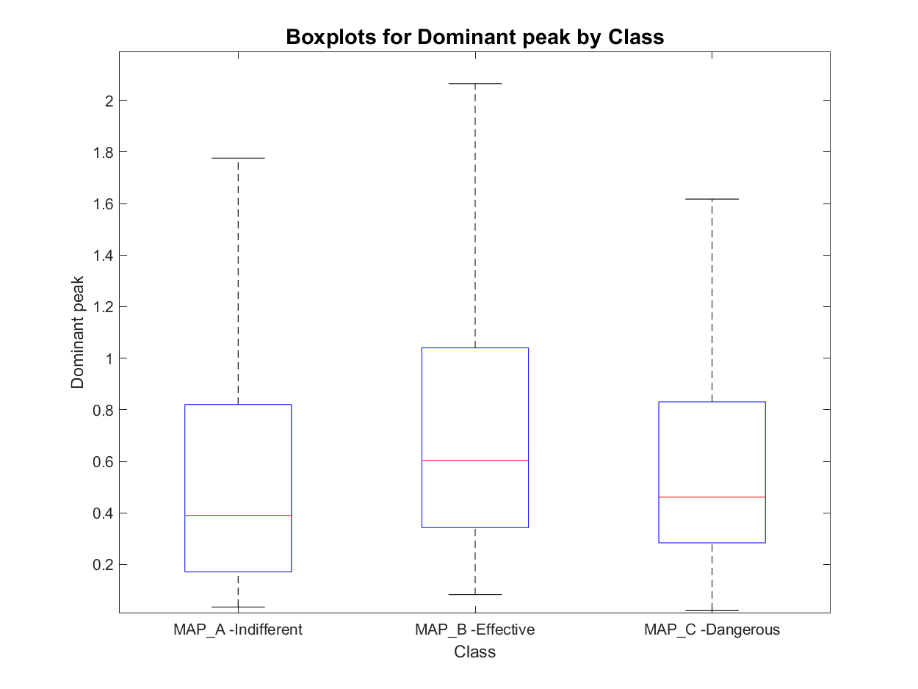
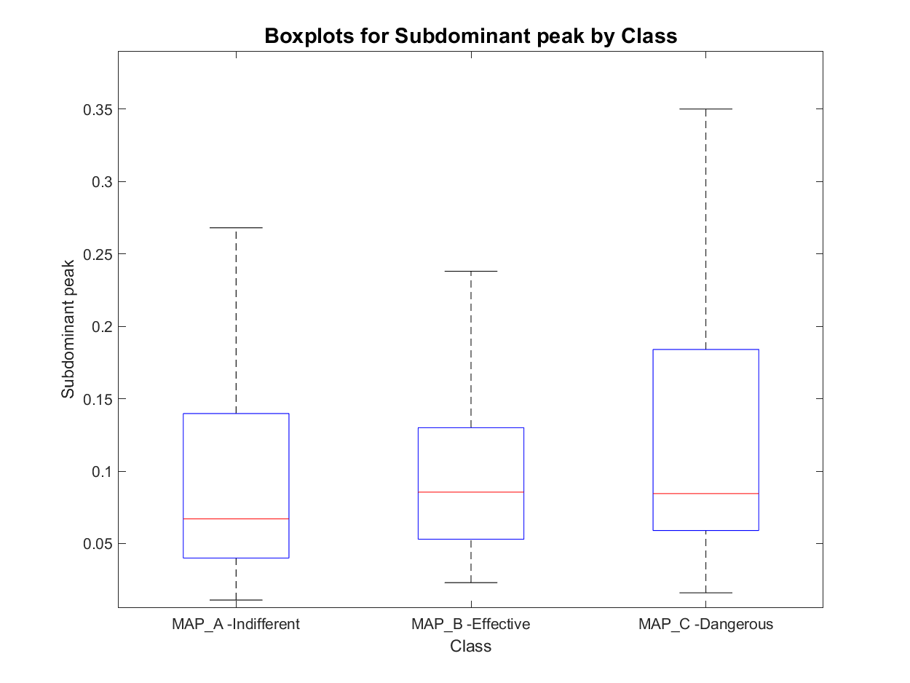
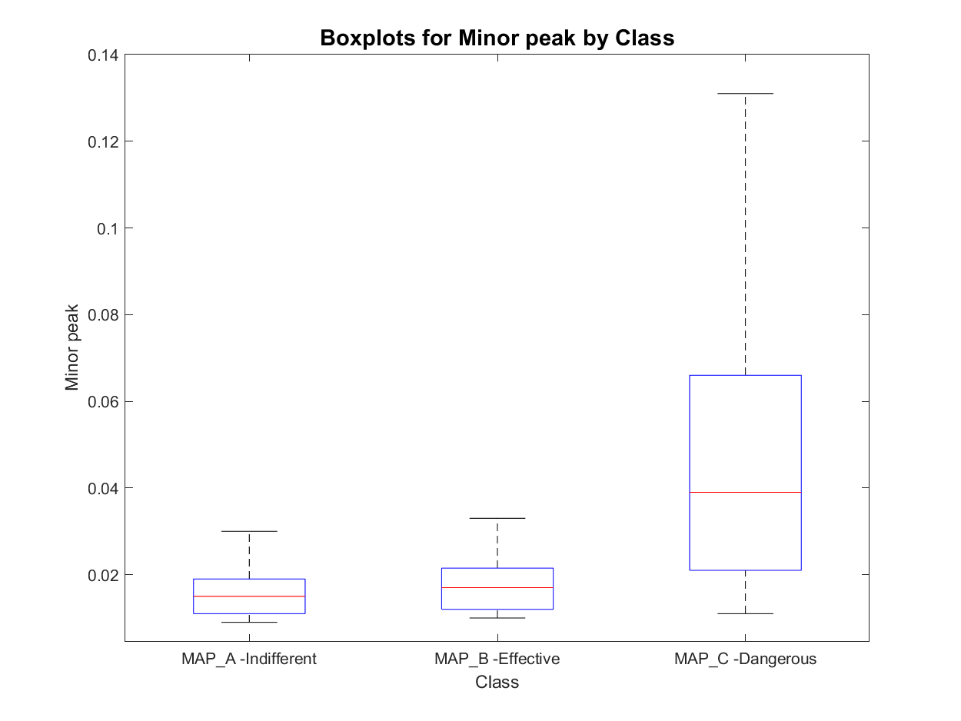
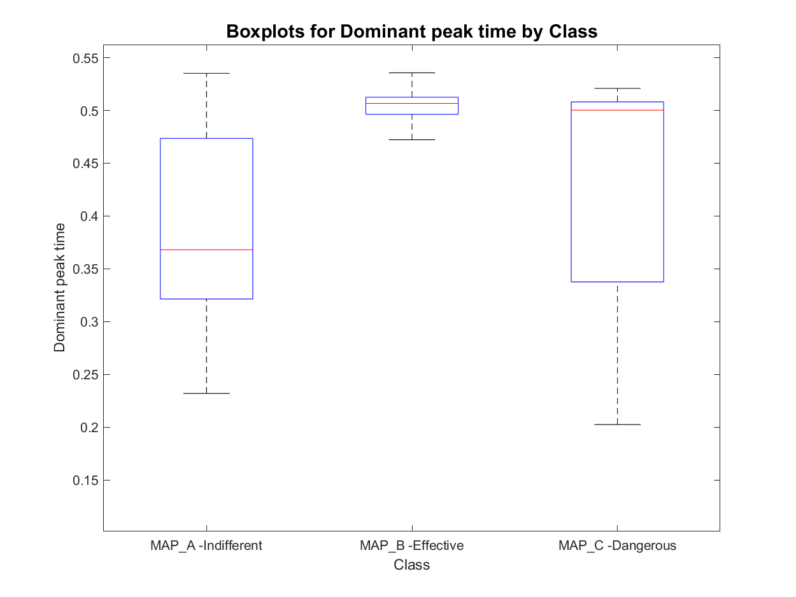
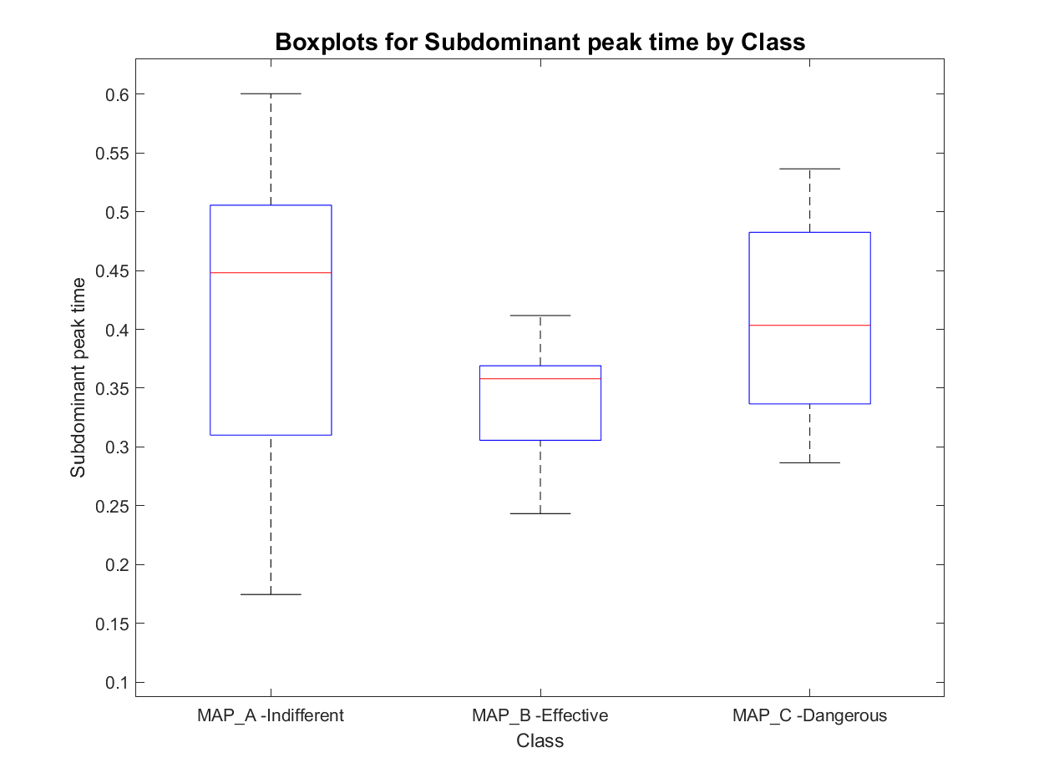
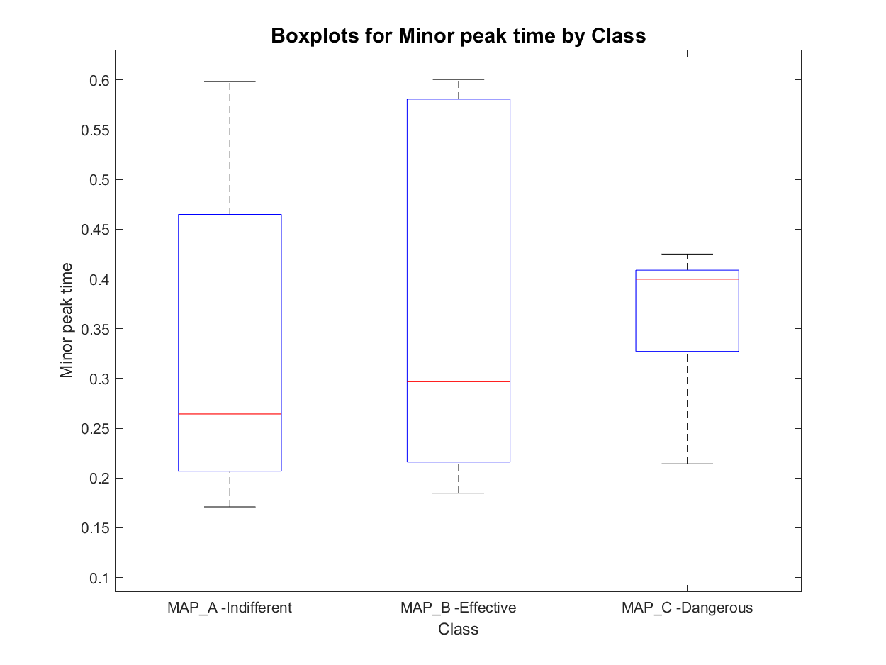
Features set 1.1: signal peak in order of magnitude
MAP_A has:
- 8 signals with one active area
- 452 signals with two active areas
- 180 signals with three active areas
- 23 signals with more than three active areas
total : 640
MAP_B has:
- 0 signals with one active area
- 67 signals with two active areas
- 26 signals with three active areas
- 1 signals with more than three active areas
total : 93
MAP_C has:
- 0 signals with one active area
- 20 signals with two active areas
- 62 signals with three active areas
- 8 signals with more than three active areas
total : 82
Prior Knowledge
Unclear behaviour

Slide 8
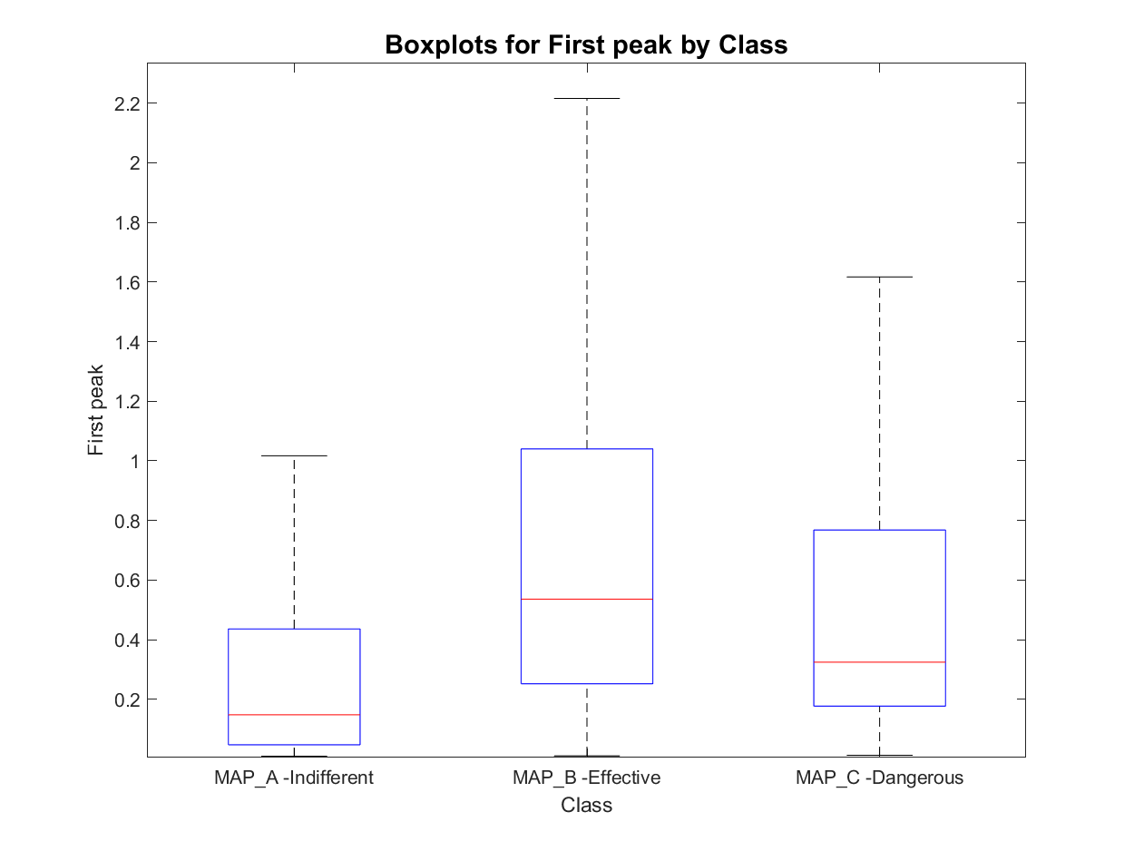
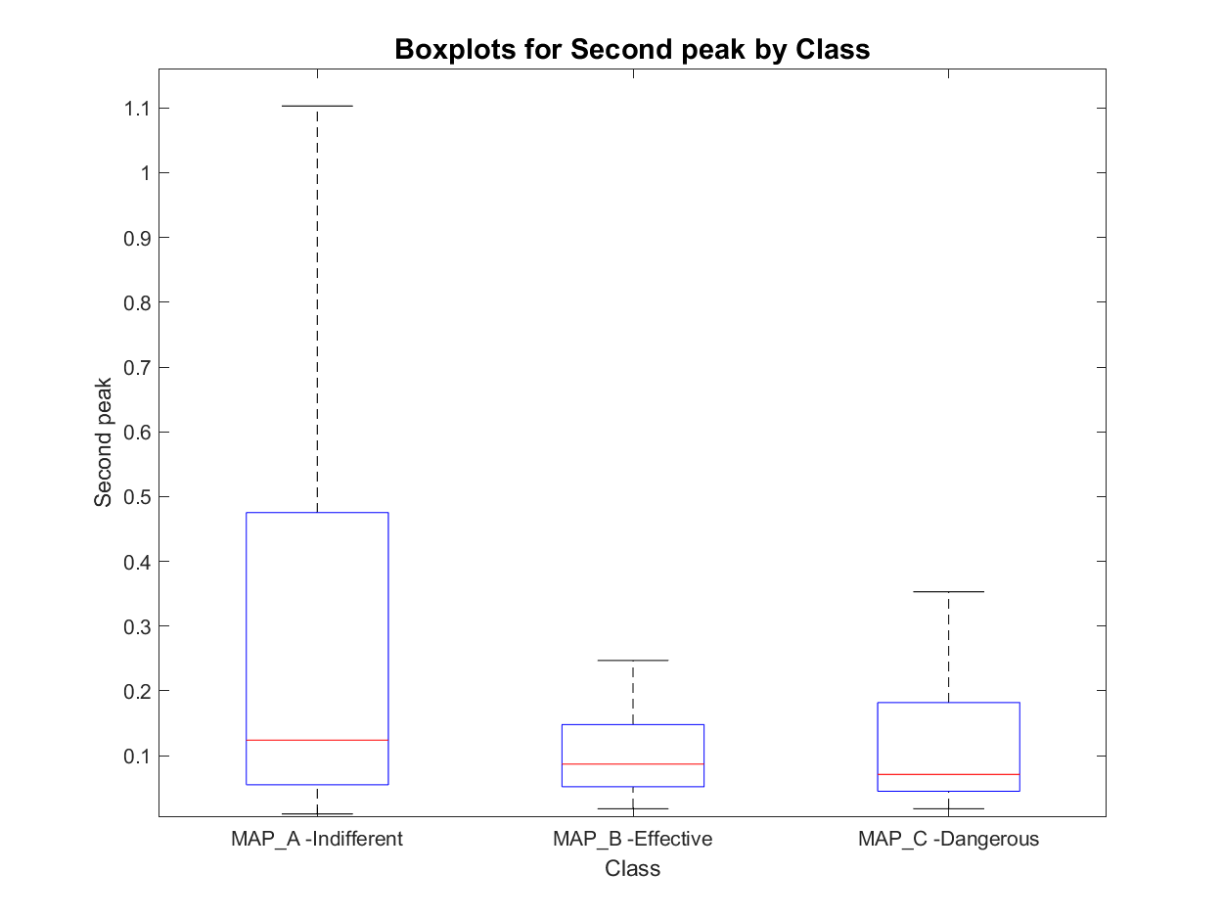
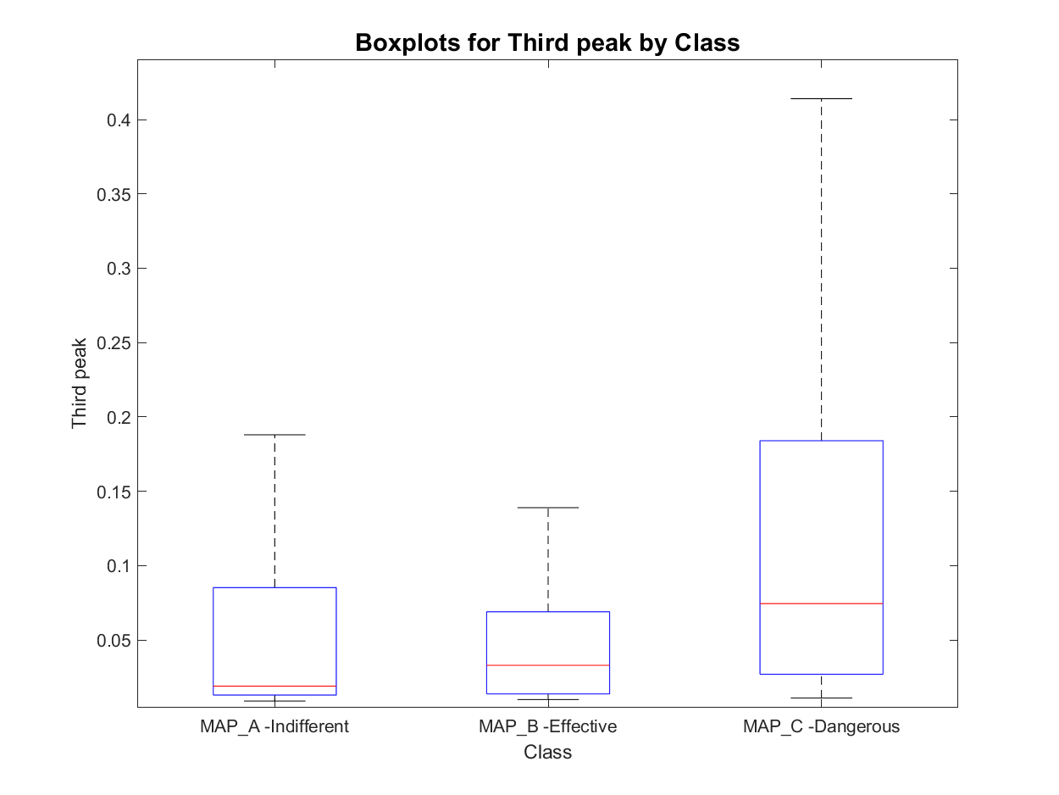
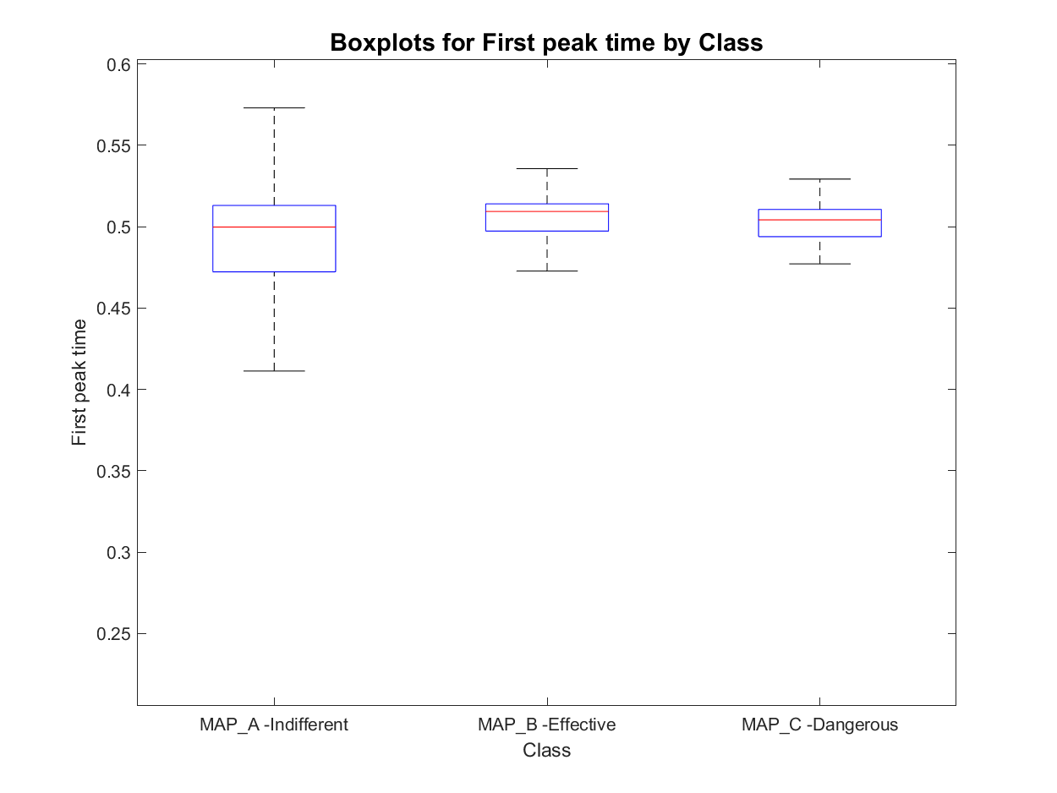
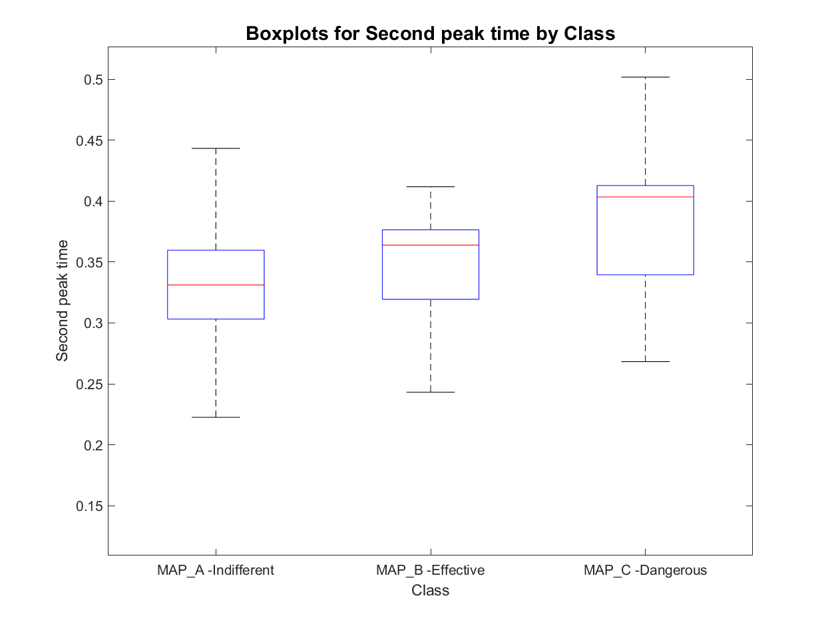
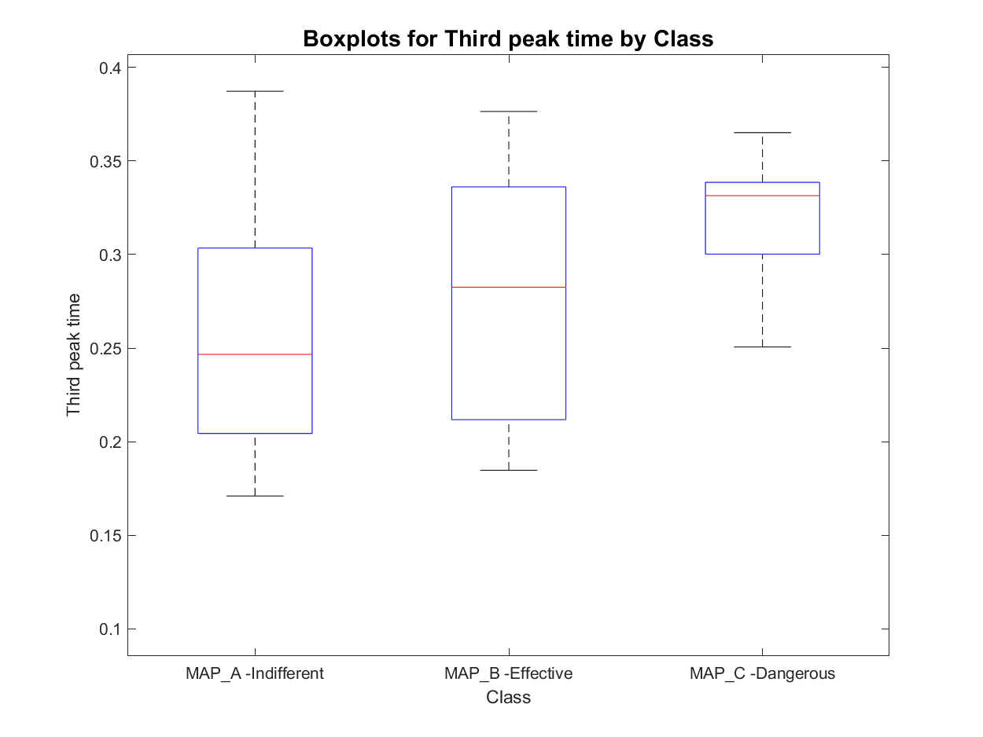
Features set 1.2: Signal peaks in order of time occurrence
MAP_A has:
- 8 signals with one active area
- 452 signals with two active areas
- 180 signals with three active areas
- 23 signals with more than three active areas
total : 640
MAP_B has:
- 0 signals with one active area
- 67 signals with two active areas
- 26 signals with three active areas
- 1 signals with more than three active areas
total : 93
MAP_C has:
- 0 signals with one active area
- 20 signals with two active areas
- 62 signals with three active areas
- 8 signals with more than three active areas
total : 82

Slide 9
Outline
Feature extraction
Envelope features
Template matching features
Short time Fourier transformation features
Classification
Knowledge based classifier: recap
Improved Knowledge based classifier
Feature correlation analysis
Tree classifier: whole set of features and optimal subset of features
SVM classifier: whole set of features and optimal subset of features
MLR classifier: whole set of features and optimal subset of features
Best model evaluation
Conclusions

Slide 10
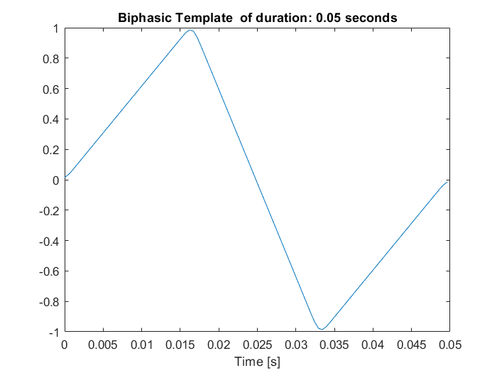
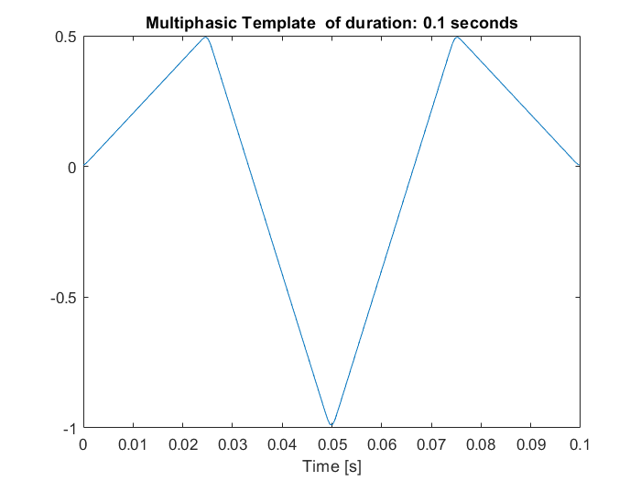
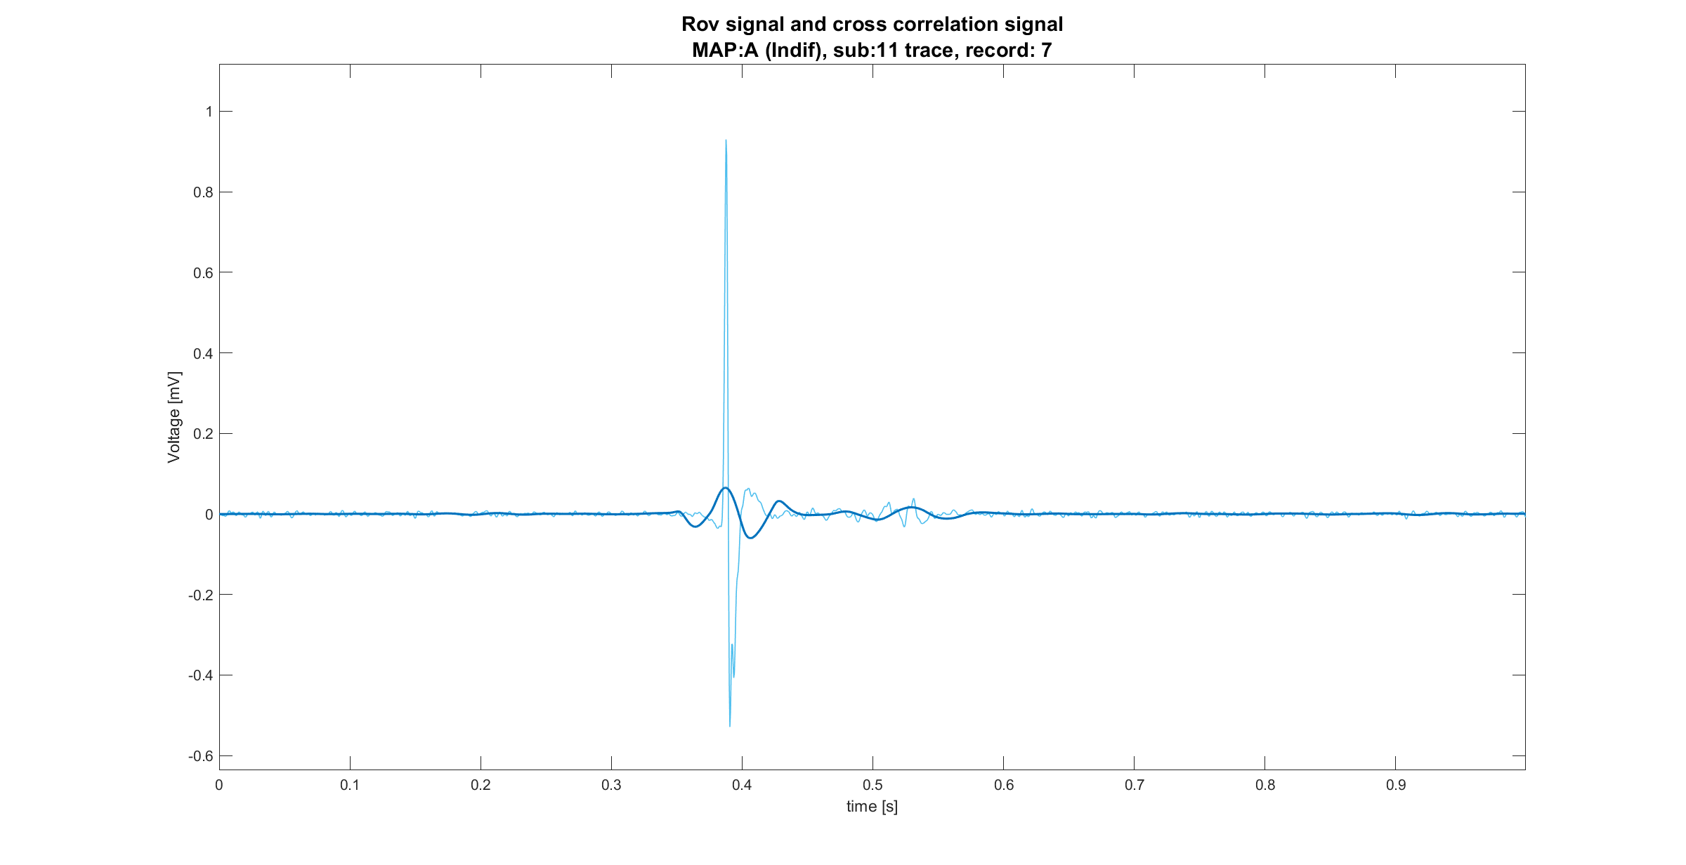
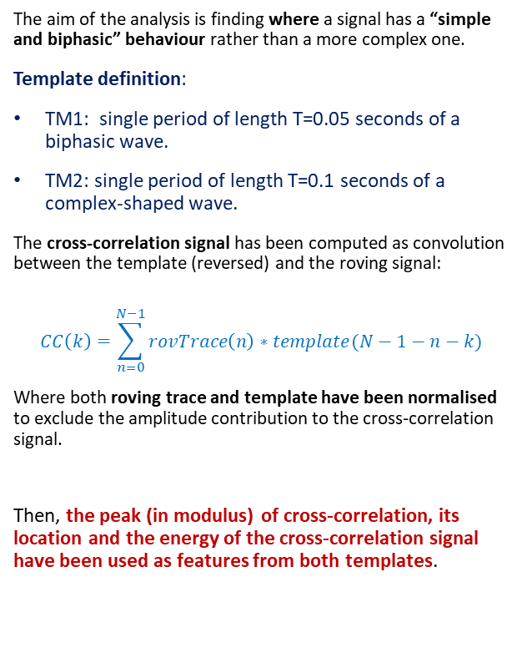
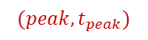
Template matching definition
The aim of the analysis is finding where a signal has a “simple and biphasic” behaviour rather than a more complex one.
Template definition:
TM1: single period of length T=0.05 seconds of a biphasic wave.
TM2: single period of length T=0.1 seconds of a complex-shaped wave.
The cross-correlation signal has been computed as convolution between the template (reversed) and the roving signal:
$$CC\left(k\right)=\sum_{n=0}^{N−1}{rovTrace\left(n\right)∗template(N−1−n−k)}$$
Where both roving trace and template have been normalised to exclude the amplitude contribution to the cross-correlation signal.
Then, the peak (in modulus) of cross-correlation, its location and the energy of the cross-correlation signal have been used as features from both templates.
$$(peak,t_{peak})$$

Slide 11
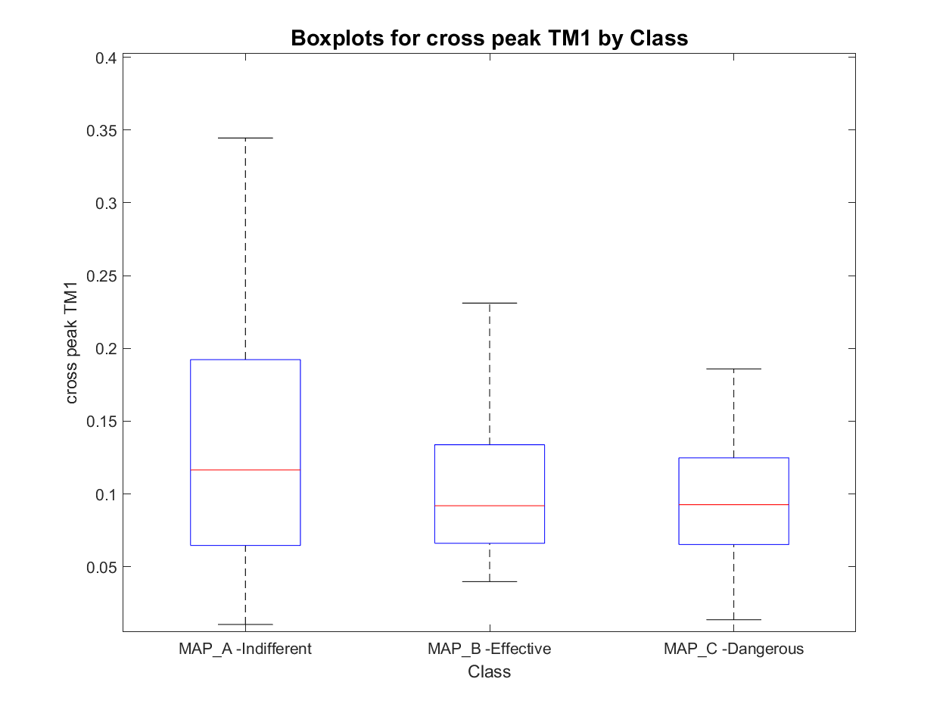
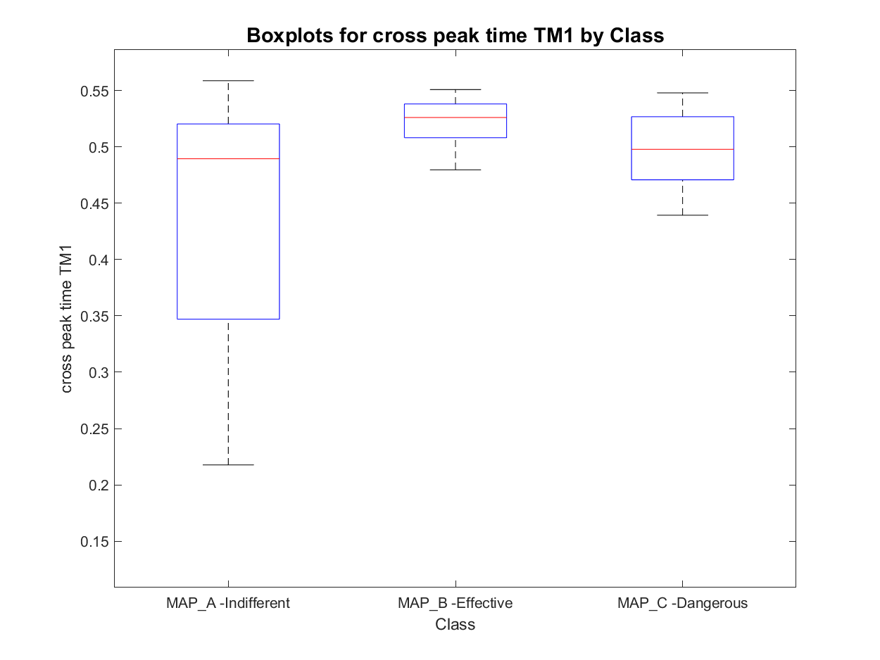
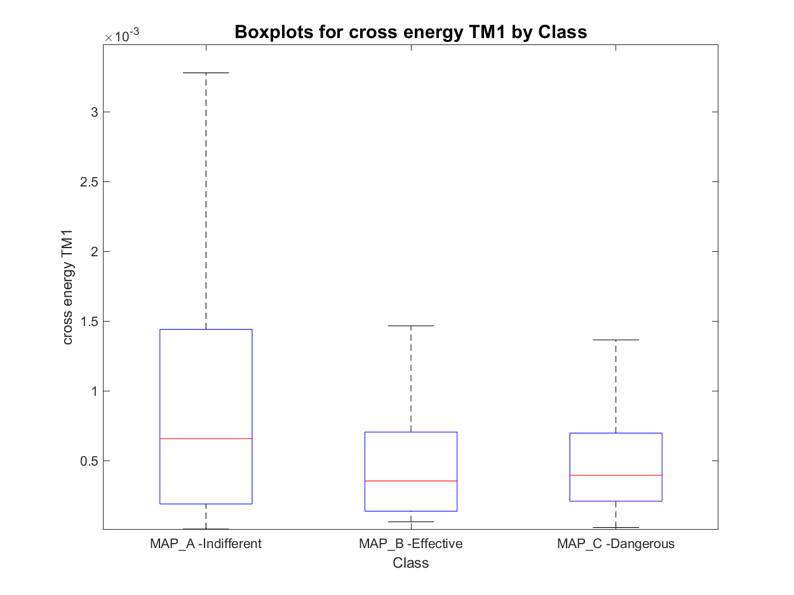
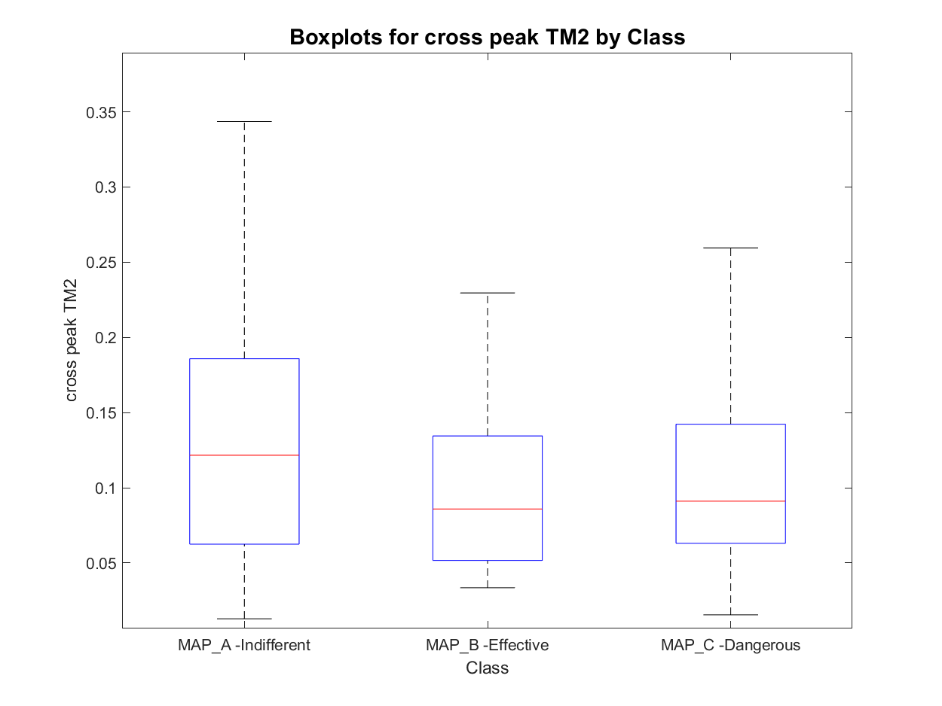
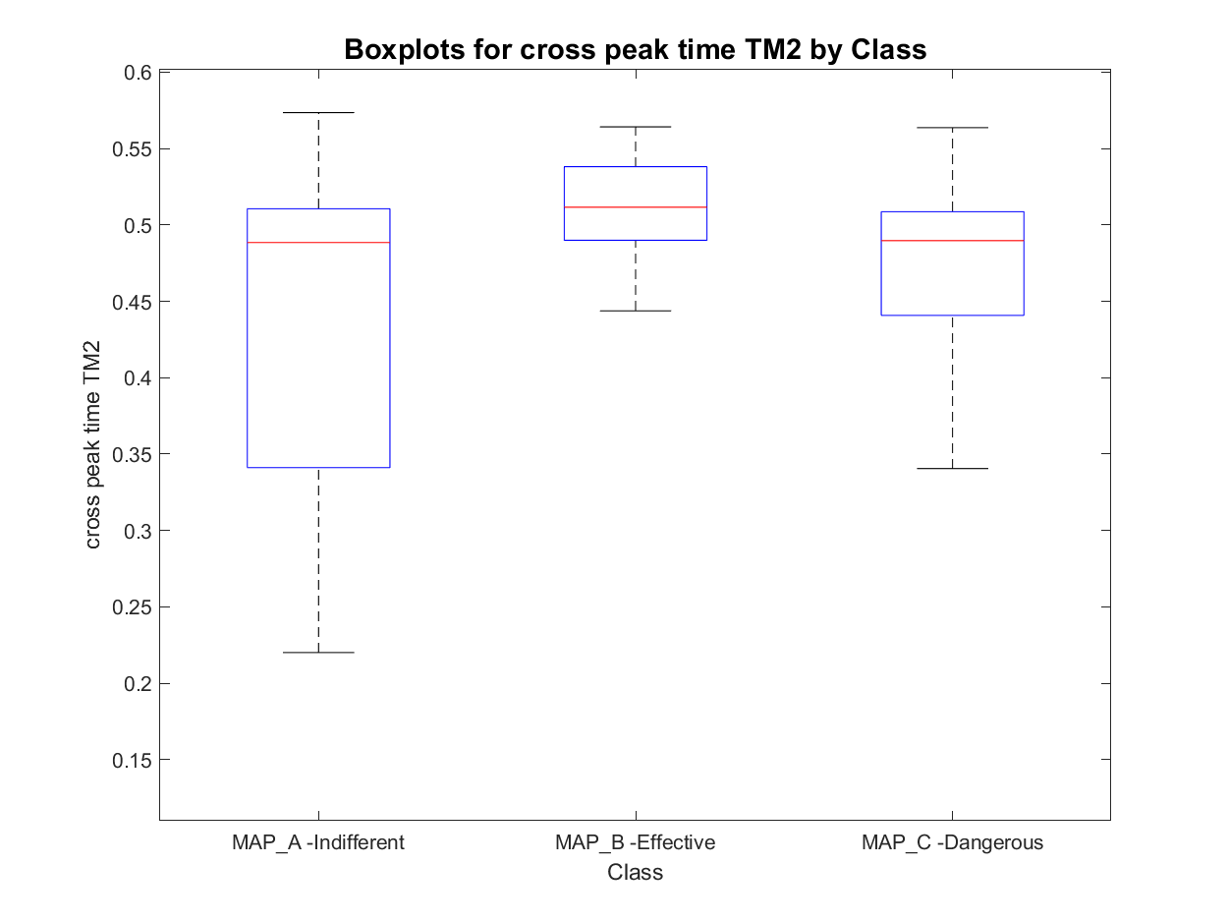
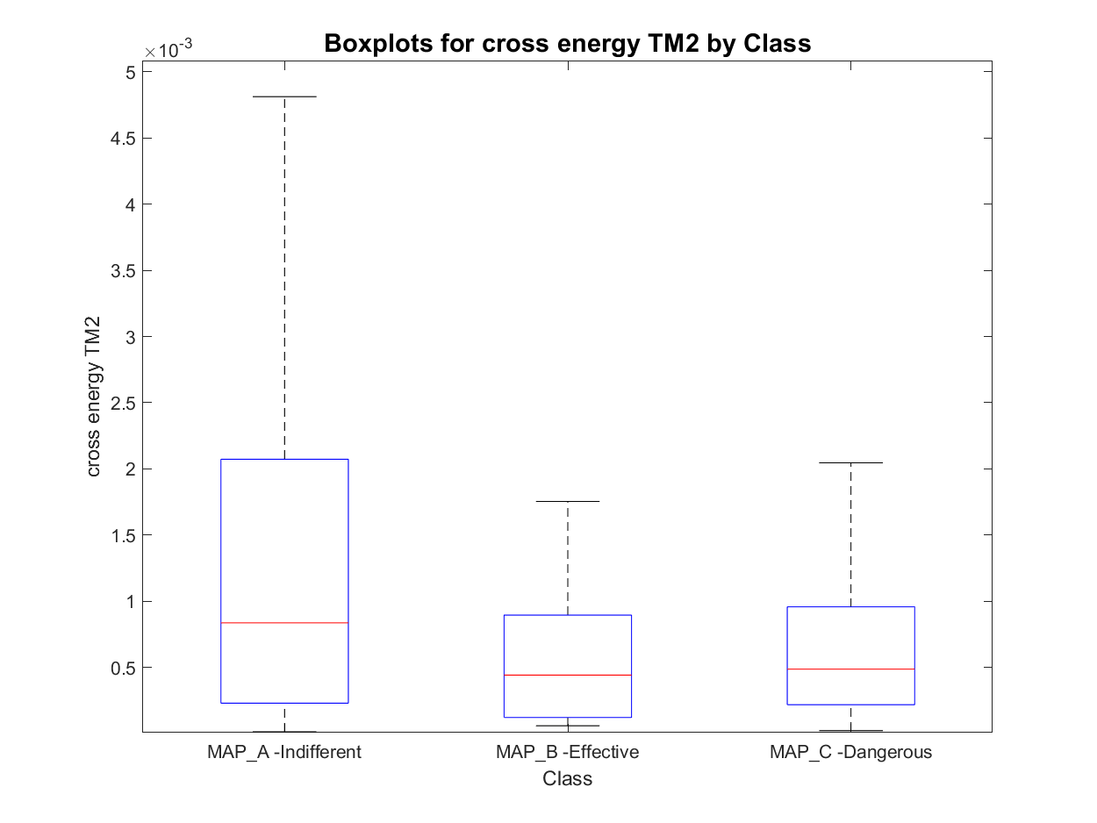
Features set 2: Template Matching features
TM1
TM2

Slide 12
Outline
Feature extraction
Envelope features
Template matching features
Short time Fourier transformation features
Classification
Knowledge based classifier: recap
Improved Knowledge based classifier
Feature correlation analysis
Tree classifier: whole set of features and optimal subset of features
SVM classifier: whole set of features and optimal subset of features
MLR classifier: whole set of features and optimal subset of features
Best model evaluation
Conclusions

Slide 13
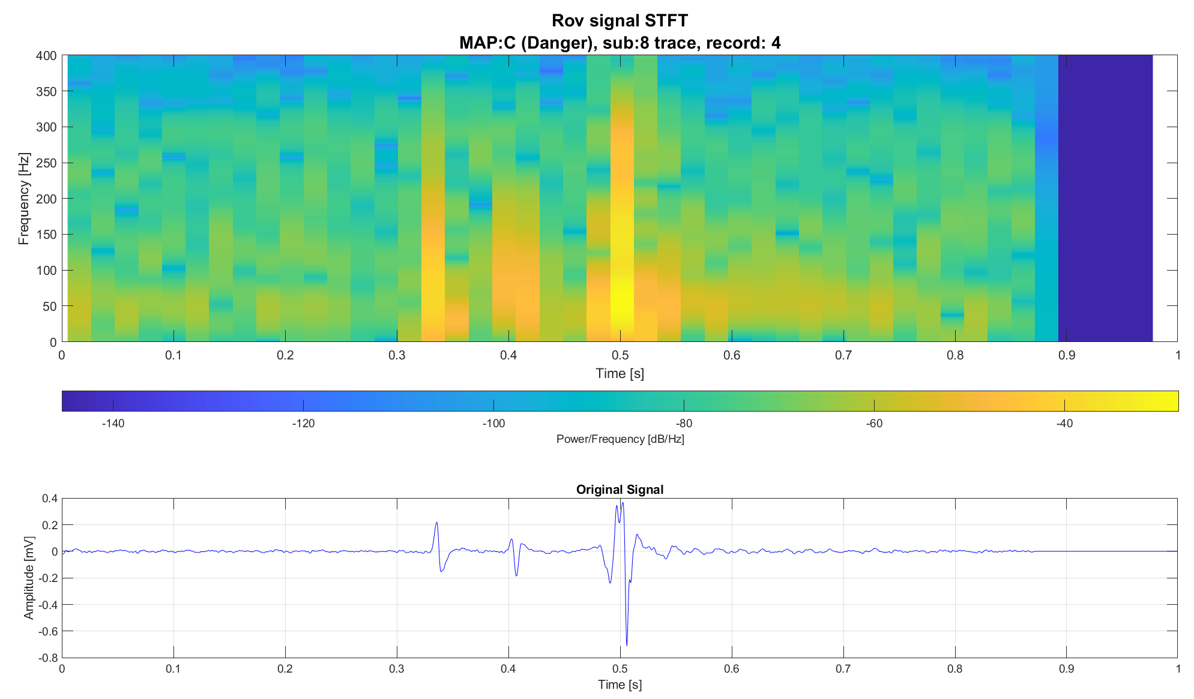
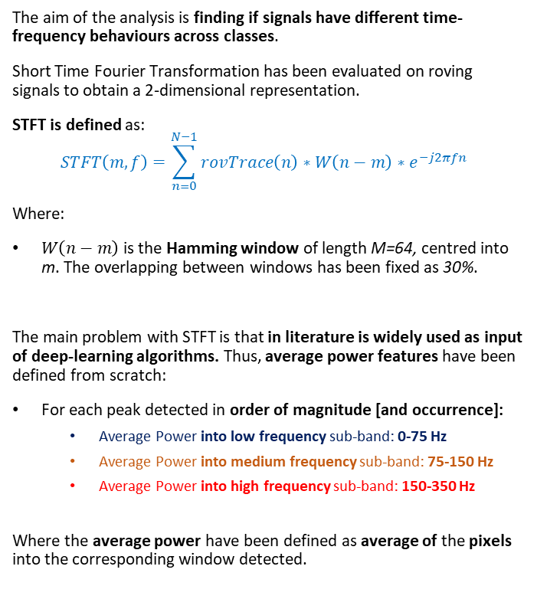
STFT definition
The aim of the analysis is finding if signals have different time-frequency behaviours across classes.
Short Time Fourier Transformation has been evaluated on roving signals to obtain a 2-dimensional representation.
STFT is defined as:
$$STFT\left(m,f\right)=\sum_{n=0}^{N−1}{rovTrace\left(n\right)∗W\left(n−m\right)∗e^{−j2πfn} }$$
Where:
$W\left(n−m\right)$ is the Hamming window of length M=64, centred into m. The overlapping between windows has been fixed as 30%.
The main problem with STFT is that in literature is widely used as input of deep-learning algorithms. Thus, average power features have been defined from scratch:
For each peak detected in order of magnitude [and occurrence]:
Average Power into low frequency sub-band: 0-75 Hz
Average Power into medium frequency sub-band: 75-150 Hz
Average Power into high frequency sub-band: 150-350 Hz
Where the average power have been defined as average of the pixels into the corresponding window detected.

Slide 14
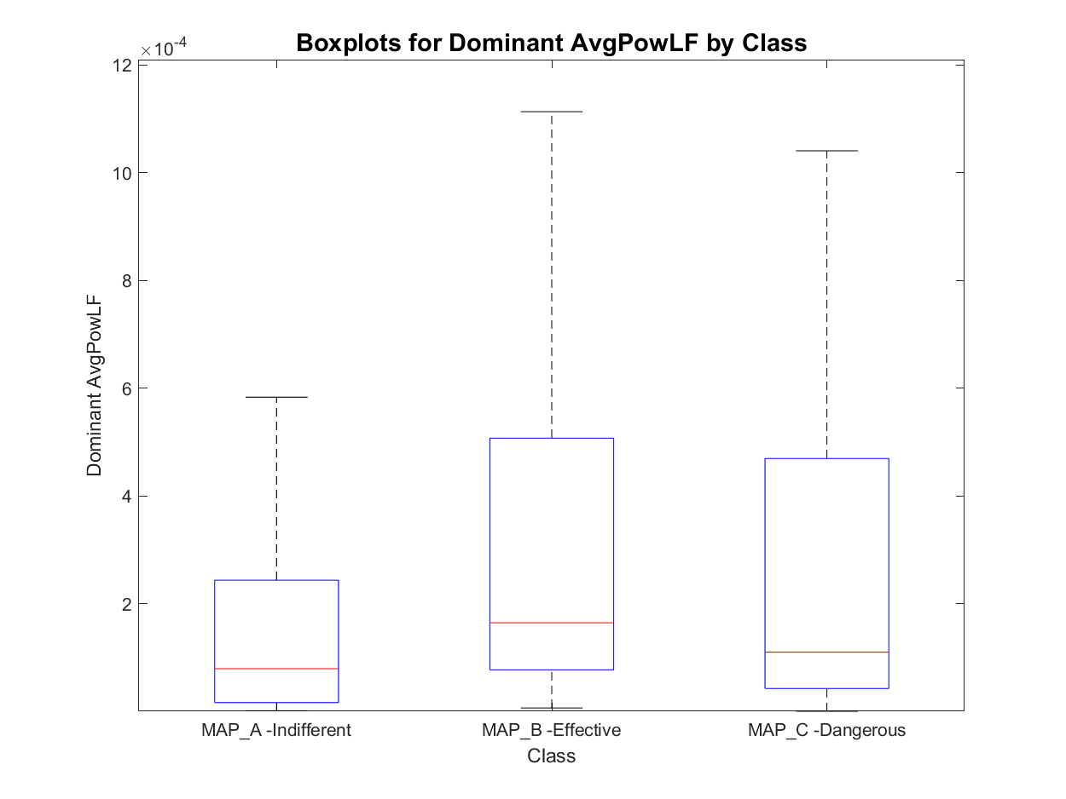
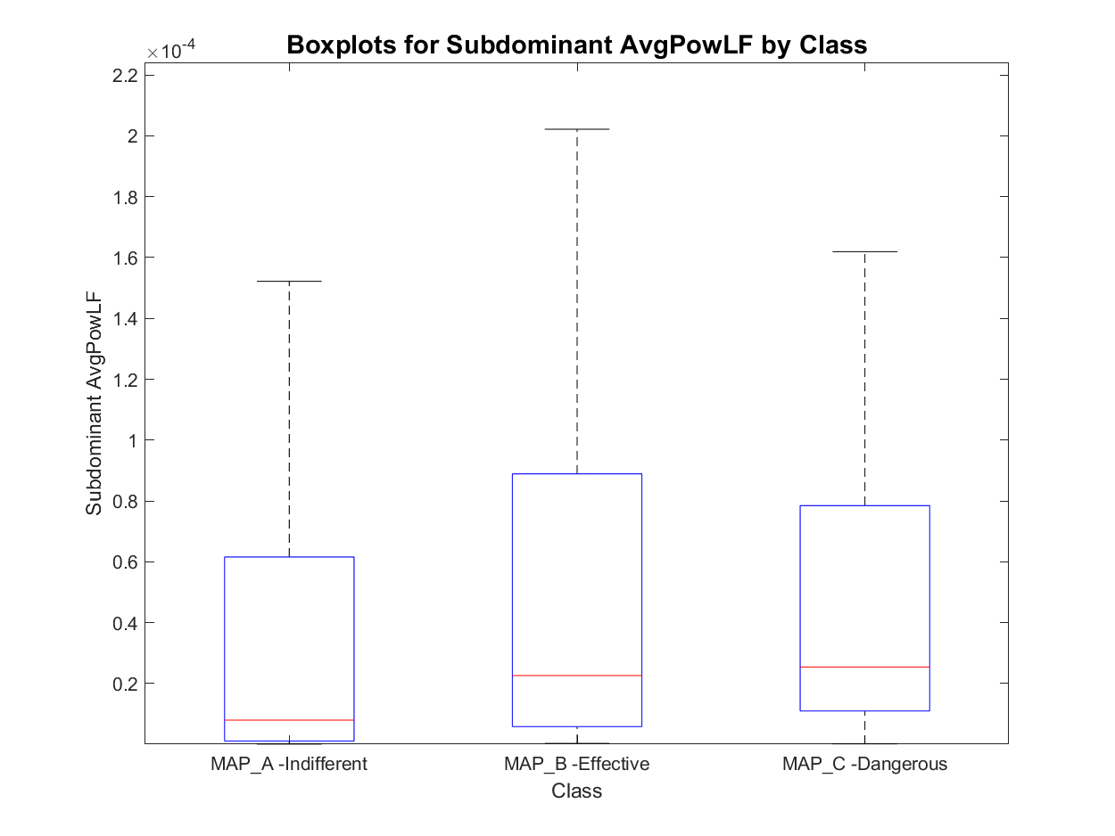
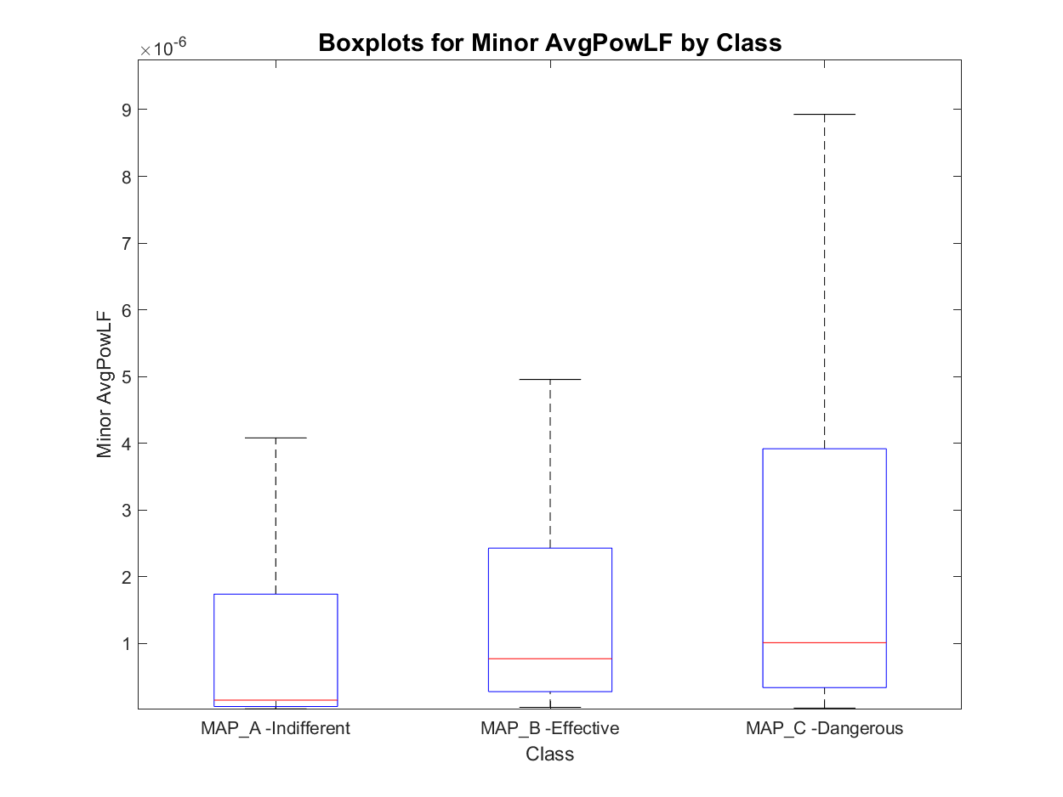
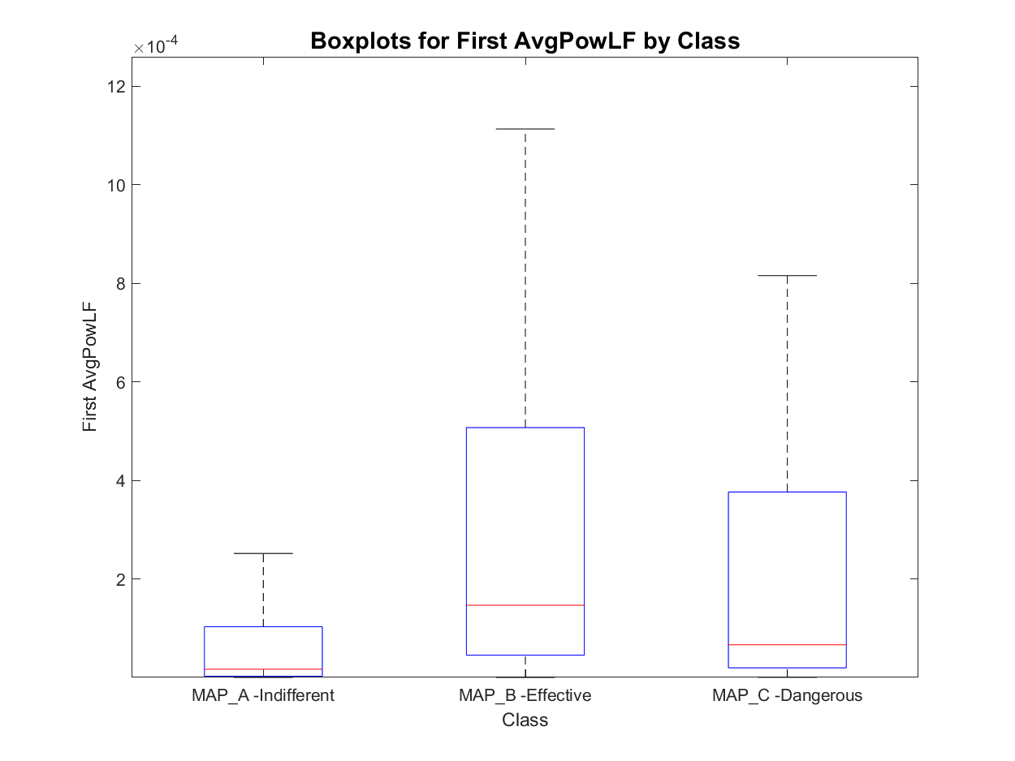
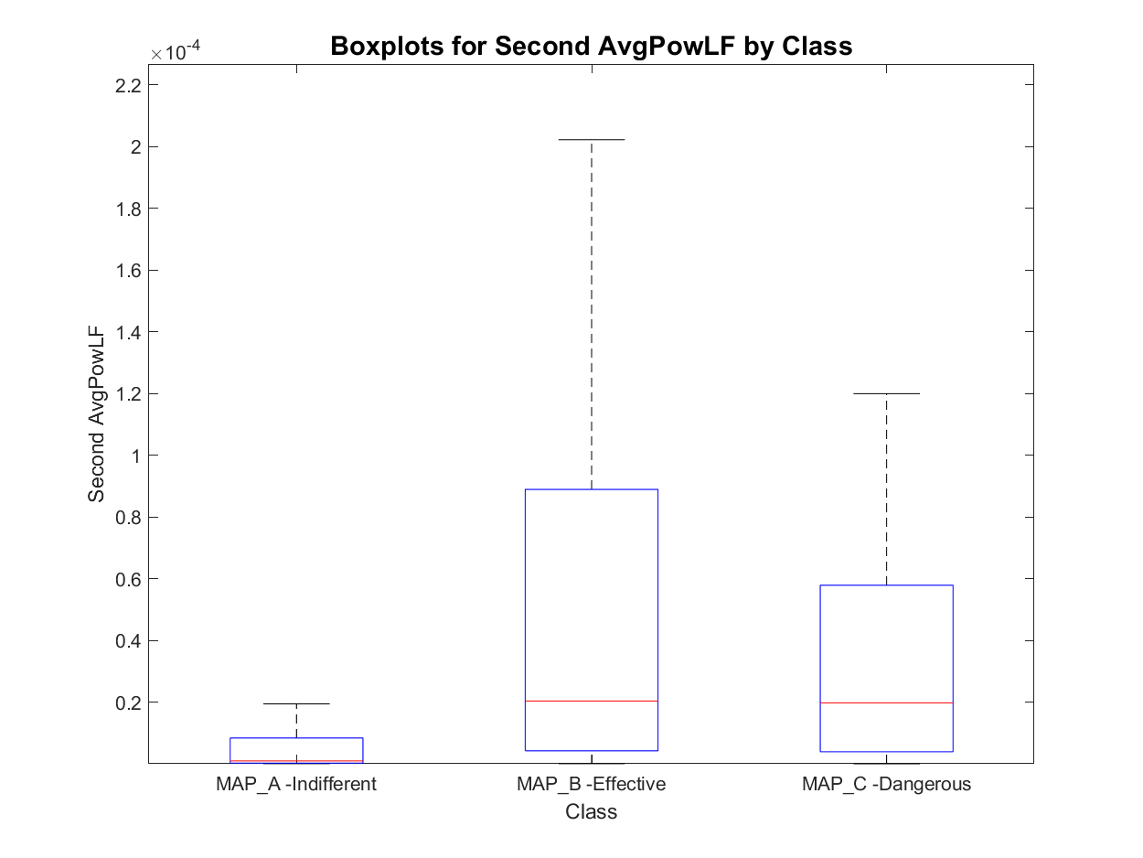
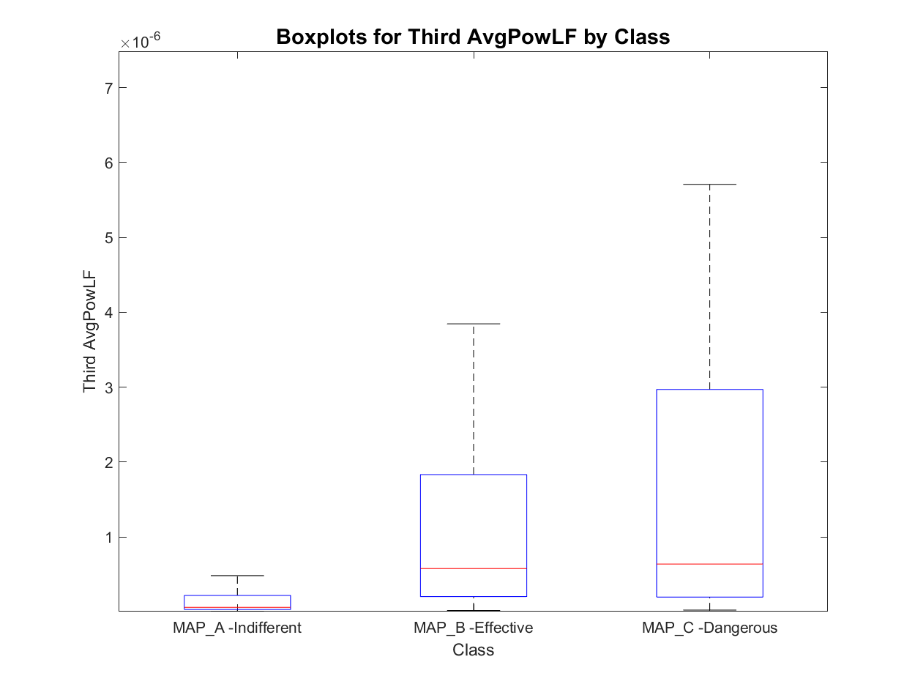
Features set 3.1: Avg LF Power of peaks
MAP_A has:
- 8 signals with one active area
- 452 signals with two active areas
- 180 signals with three active areas
- 23 signals with more than three active areas
total : 640
MAP_B has:
- 0 signals with one active area
- 67 signals with two active areas
- 26 signals with three active areas
- 1 signals with more than three active areas
total : 93
MAP_C has:
- 0 signals with one active area
- 20 signals with two active areas
- 62 signals with three active areas
- 8 signals with more than three active areas
total : 82
Order of magnitude
Order of occurrence

Slide 15
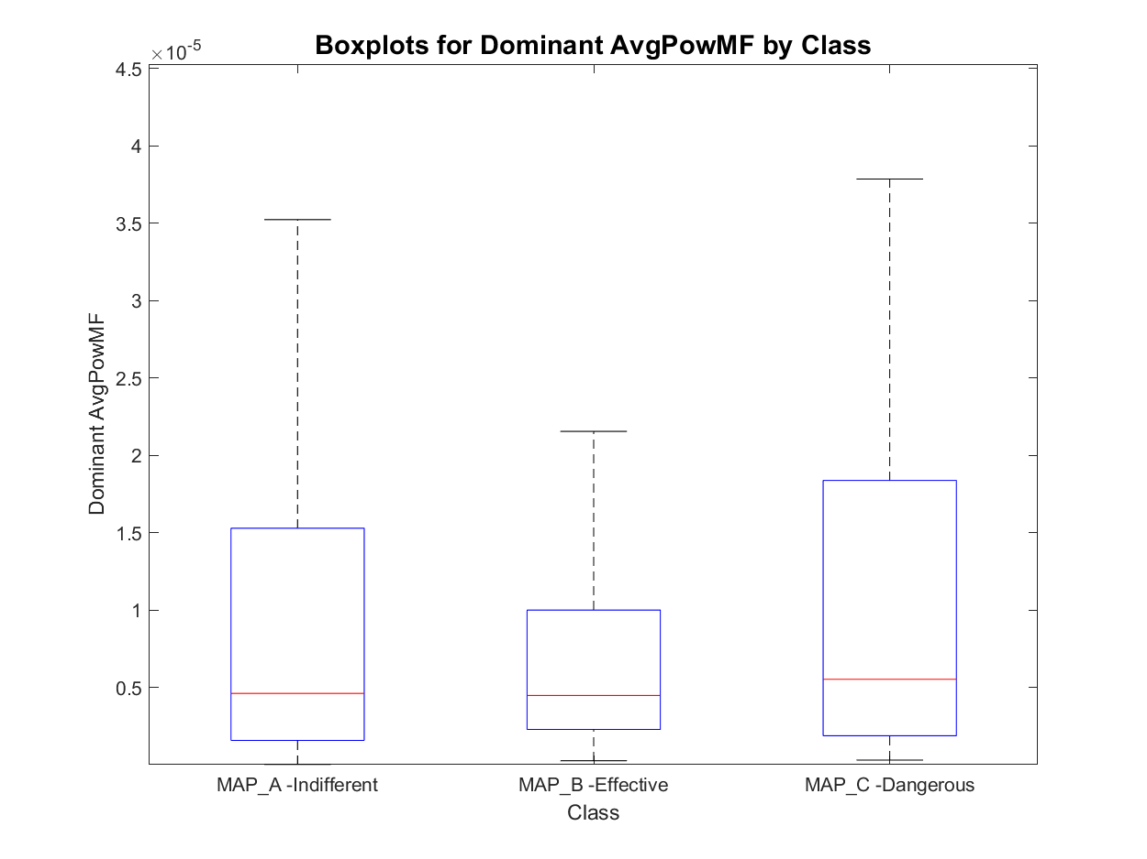
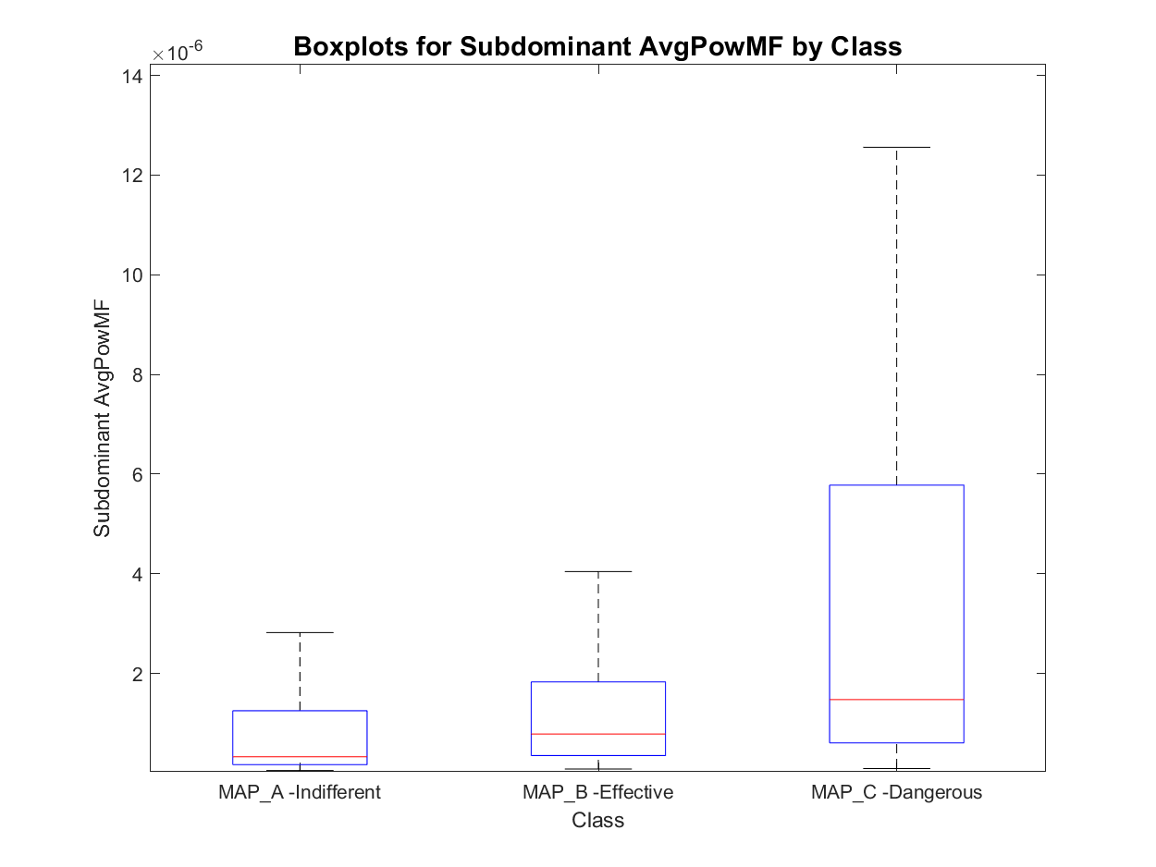
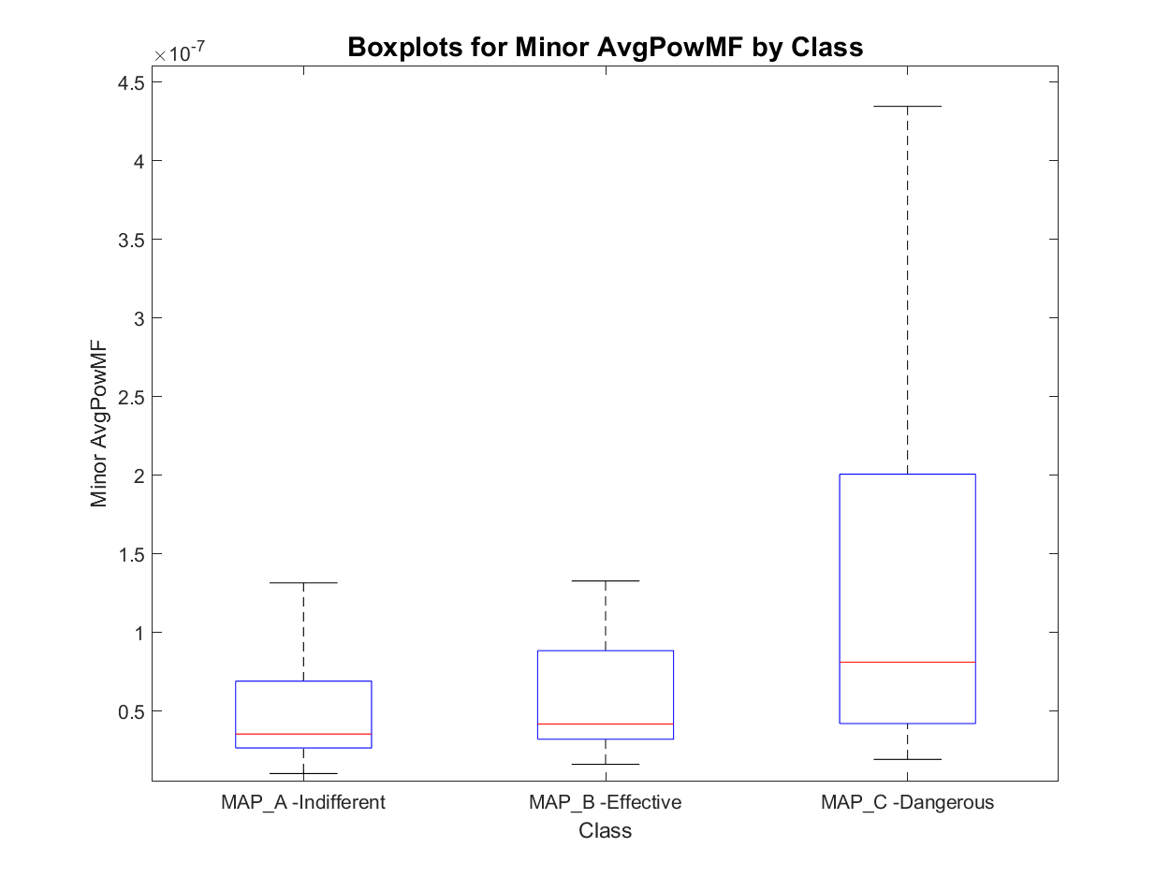
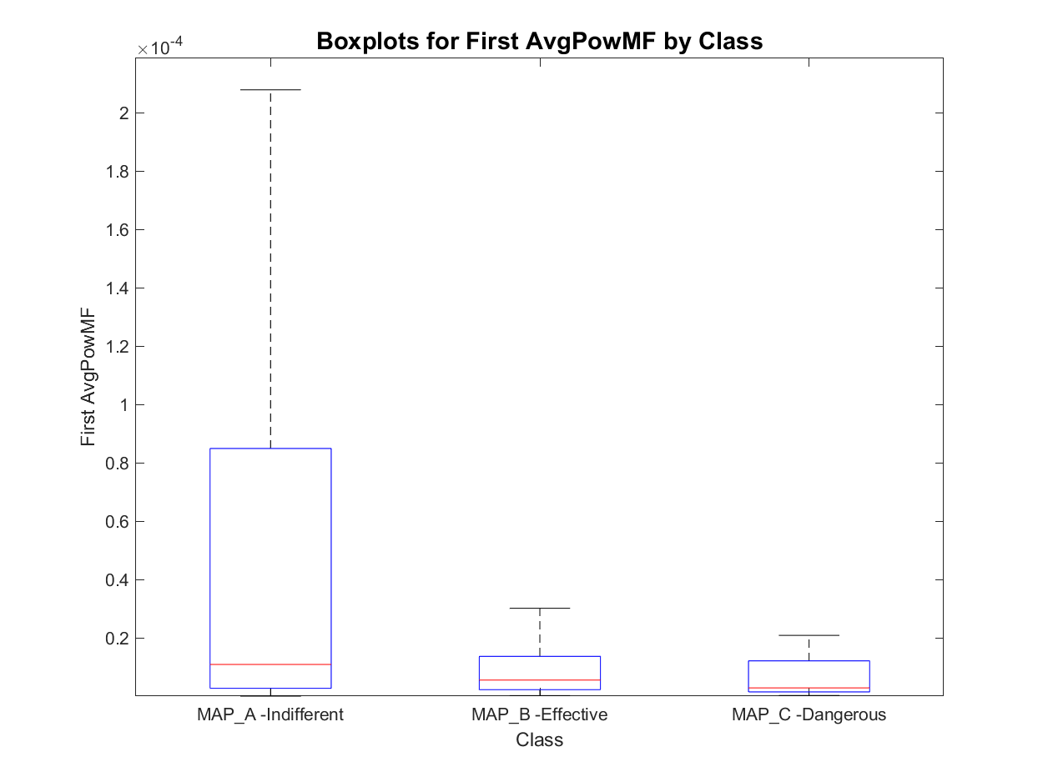
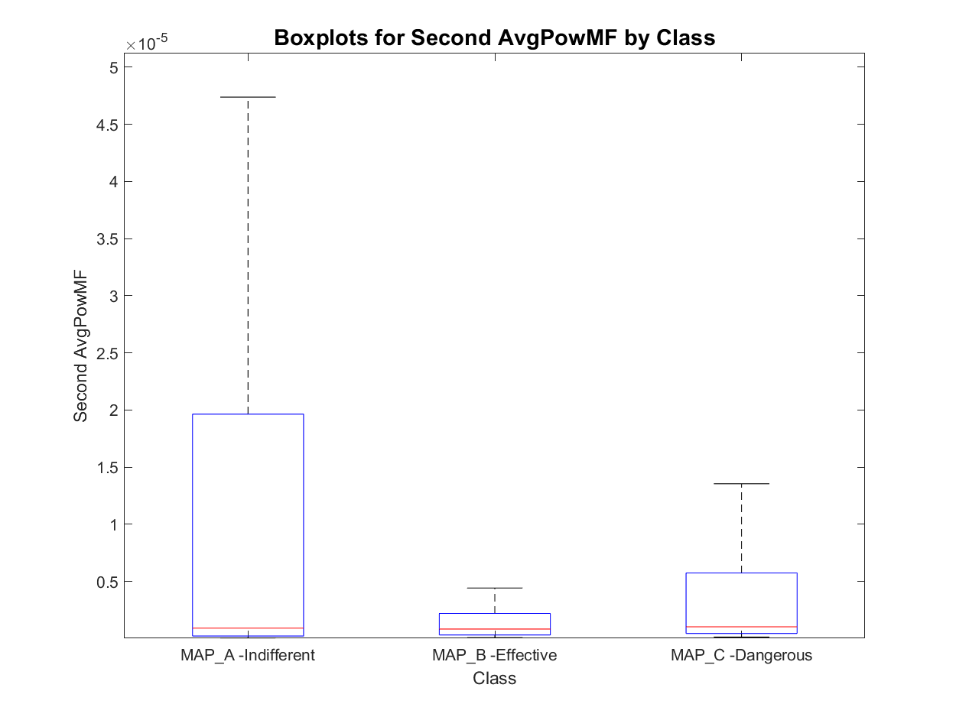
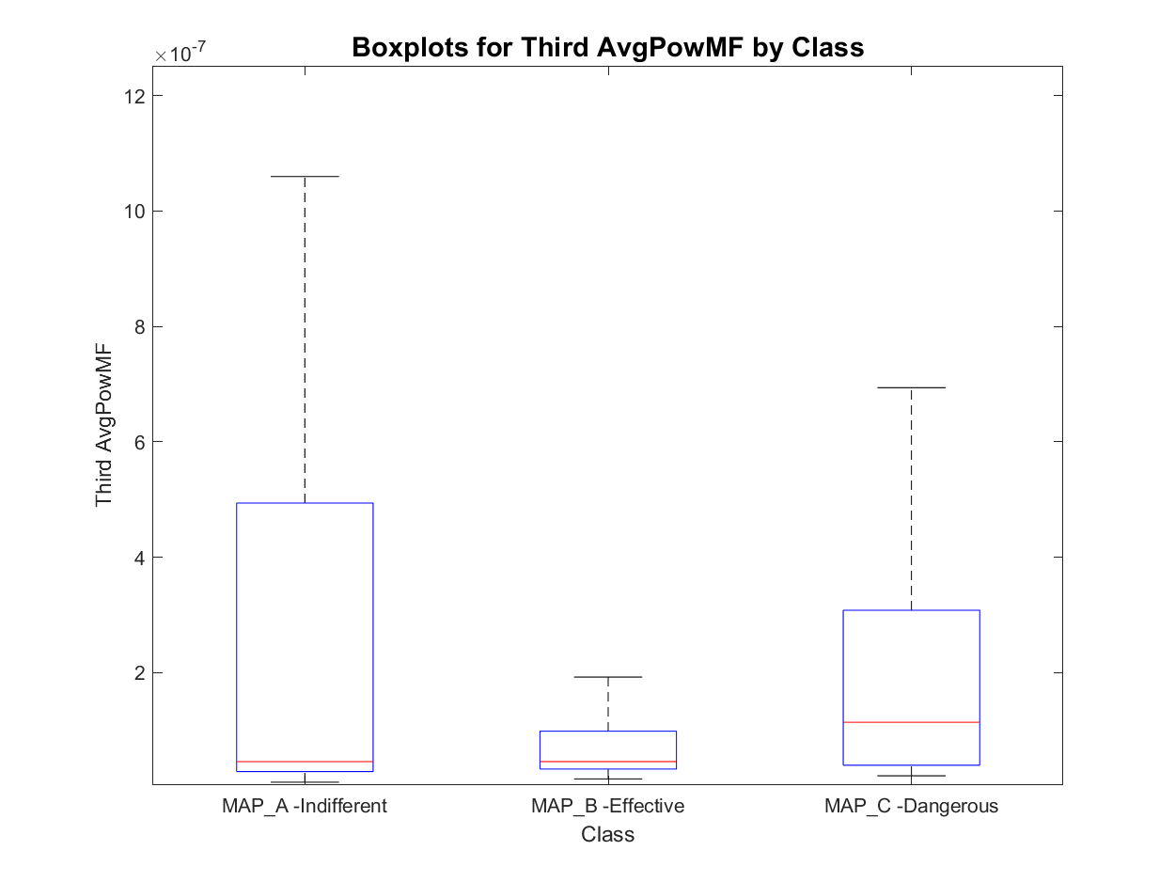
Features set 3.1: Avg MF Power of peaks
MAP_A has:
- 8 signals with one active area
- 452 signals with two active areas
- 180 signals with three active areas
- 23 signals with more than three active areas
total : 640
MAP_B has:
- 0 signals with one active area
- 67 signals with two active areas
- 26 signals with three active areas
- 1 signals with more than three active areas
total : 93
MAP_C has:
- 0 signals with one active area
- 20 signals with two active areas
- 62 signals with three active areas
- 8 signals with more than three active areas
total : 82
Order of magnitude
Order of occurrence

Slide 16
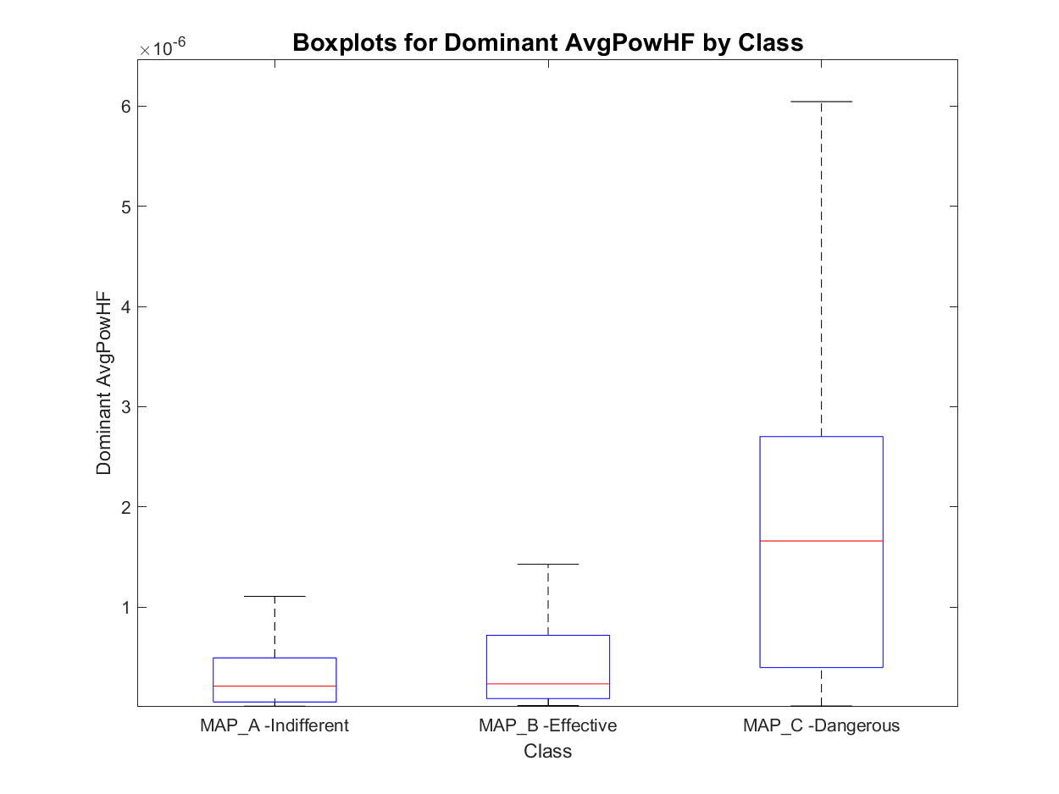
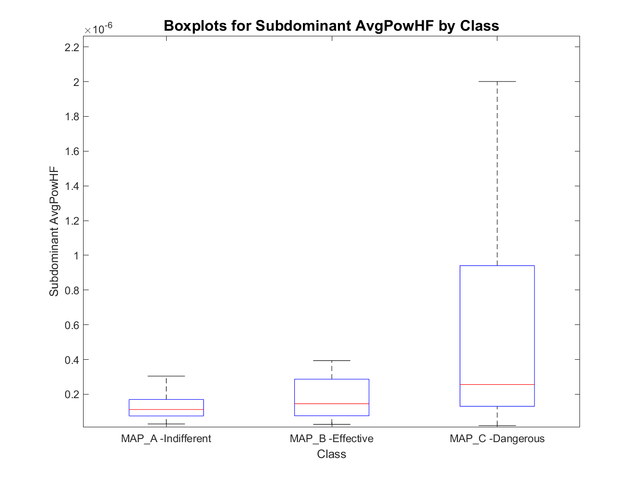
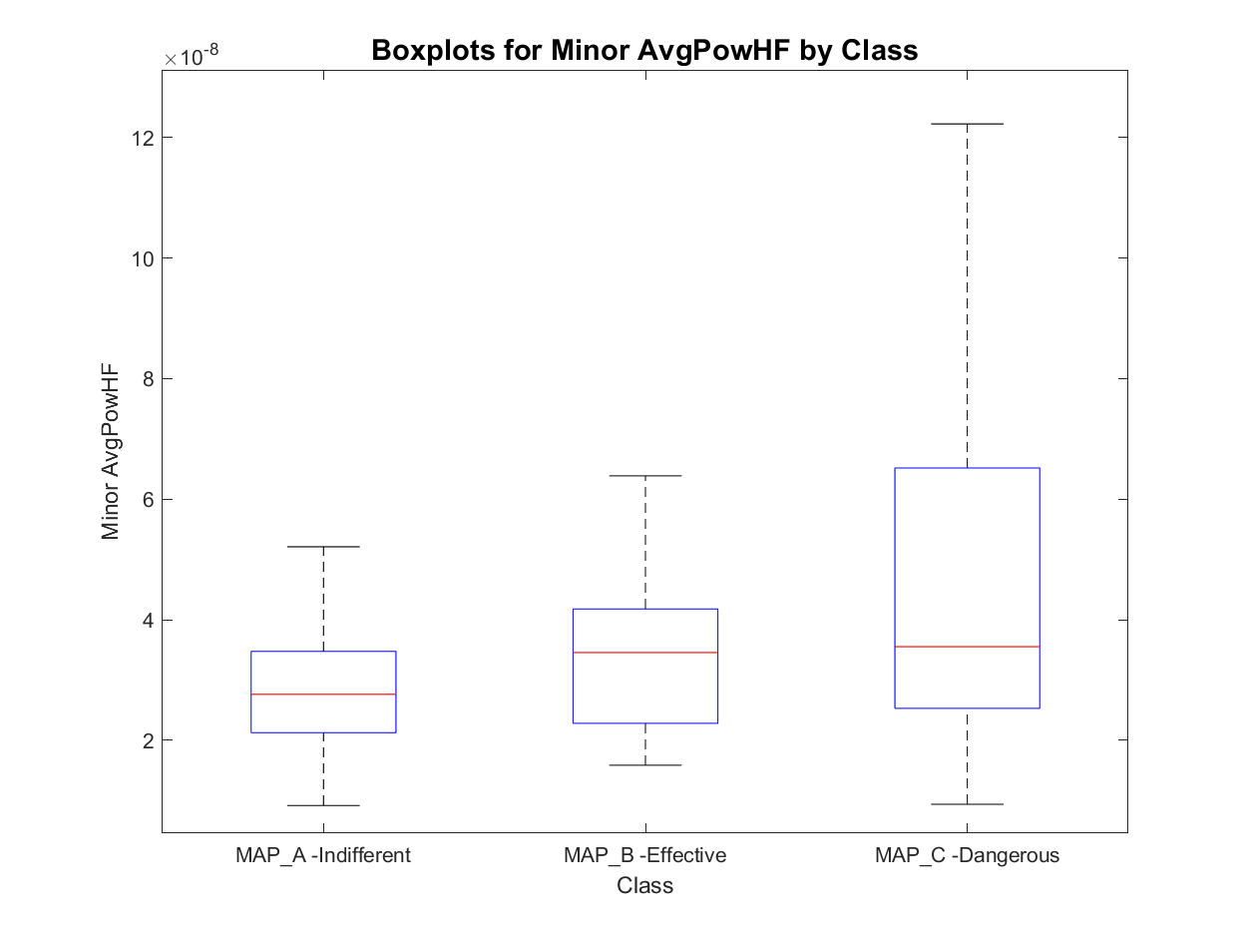
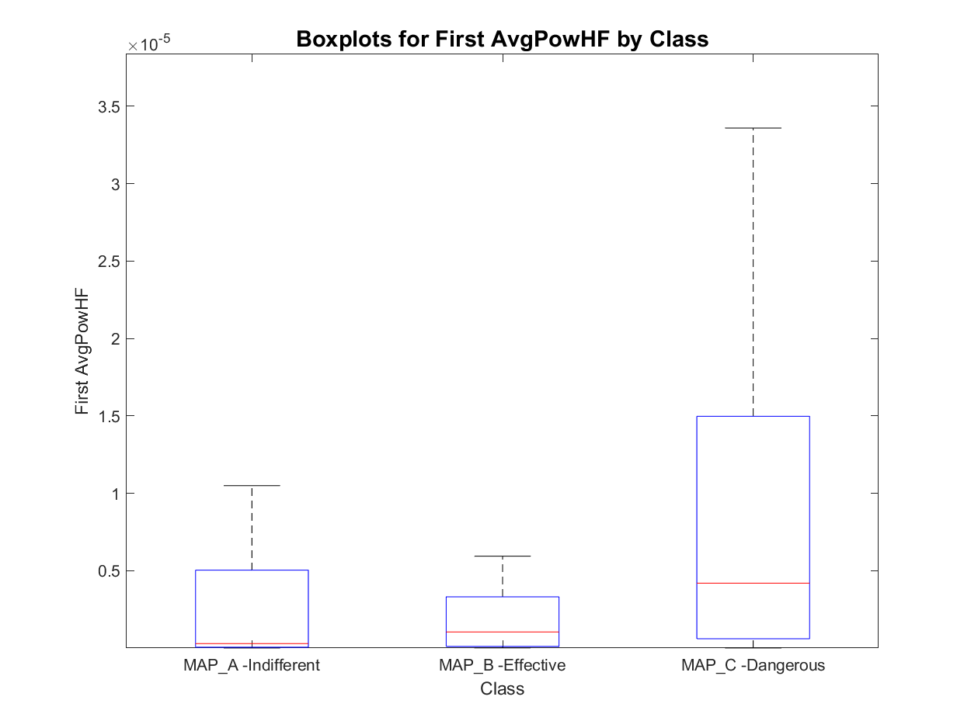
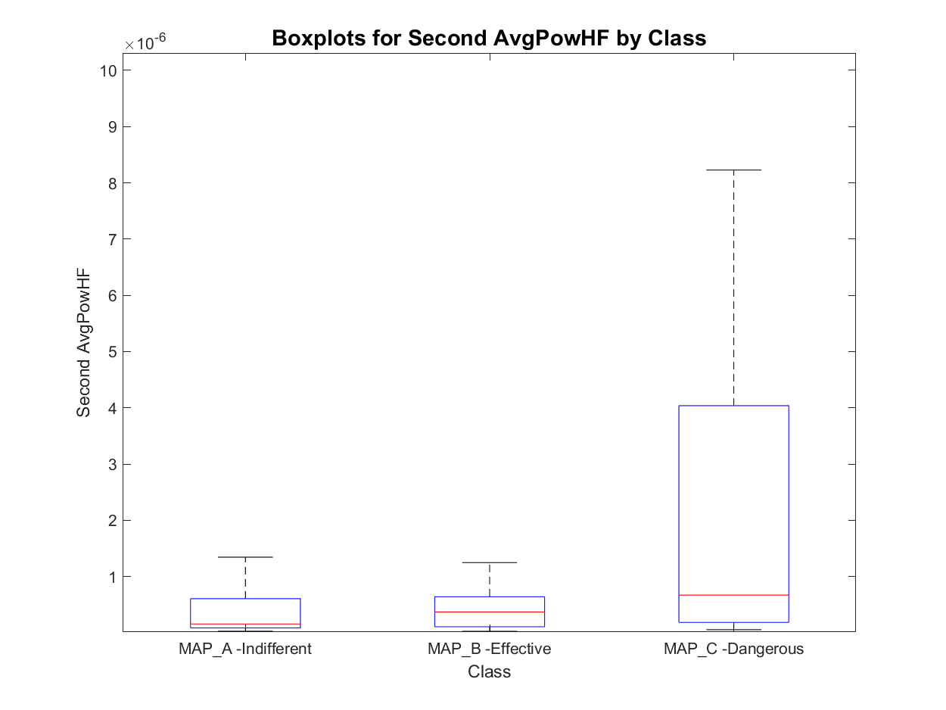
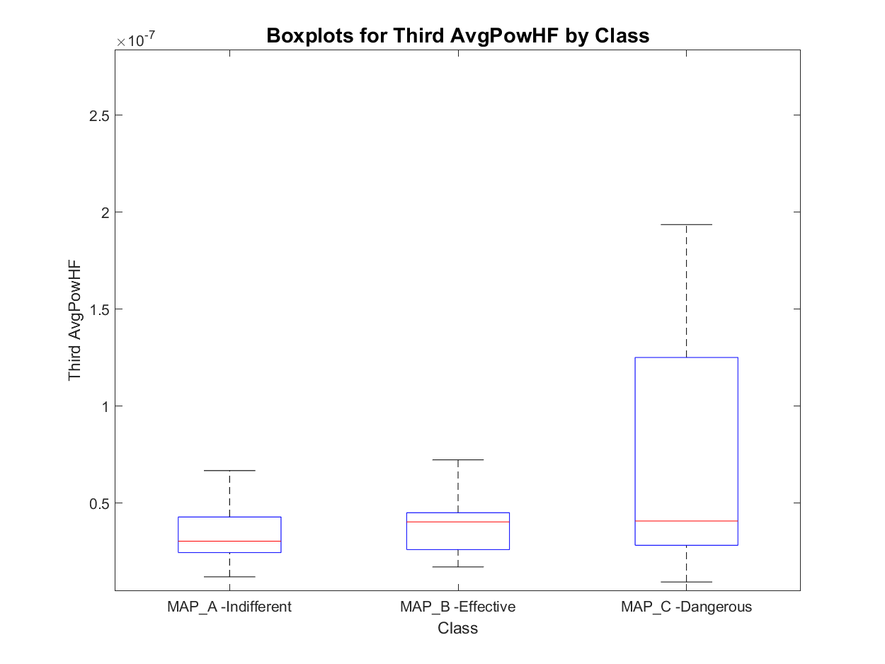
Features set 3.1: Avg HF Power of peaks
MAP_A has:
- 8 signals with one active area
- 452 signals with two active areas
- 180 signals with three active areas
- 23 signals with more than three active areas
total : 640
MAP_B has:
- 0 signals with one active area
- 67 signals with two active areas
- 26 signals with three active areas
- 1 signals with more than three active areas
total : 93
MAP_C has:
- 0 signals with one active area
- 20 signals with two active areas
- 62 signals with three active areas
- 8 signals with more than three active areas
total : 82
Order of magnitude
Order of occurrence

Slide 17
Outline
Feature extraction
Envelope features
Template matching features
Short time Fourier transformation features
Classification
Knowledge based classifier: recap
Improved Knowledge based classifier
Feature correlation analysis
Tree classifier: whole set of features and optimal subset of features
SVM classifier: whole set of features and optimal subset of features
MLR classifier: whole set of features and optimal subset of features
Best model evaluation
Conclusions

Slide 18
Knowledge based classifier: recap
For each roving trace:
Divide the trace in three regions (Atrial: t<0.38s, His: 0.38<t<0.42 and Ventricular: 0.42<t<0.6);
Compute the absolute value of each region and find the maximum;
Then, apply the following rules:
KB V0: atrial peak thresholding
KB V1: atrial/ventricular ratio (Th: 05)
Is the His Peak above threshold?
No
Is the atrial peak > 0.5 mV?
No
Is the His Peak above threshold?
No
Is the atrial/ventricular peak ratio >threshold?
No
MAP B
MAP B
Yes
Yes
Yes
Yes
MAP C
MAP A
MAP C
MAP A

Slide 19
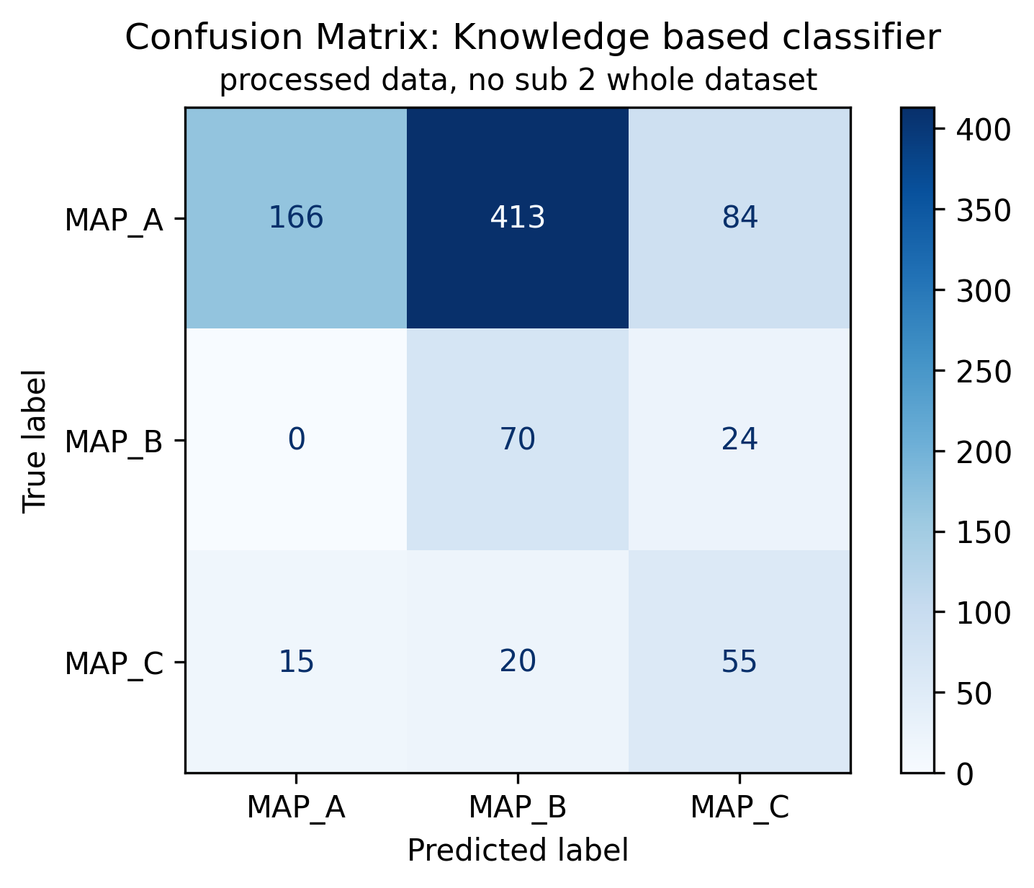
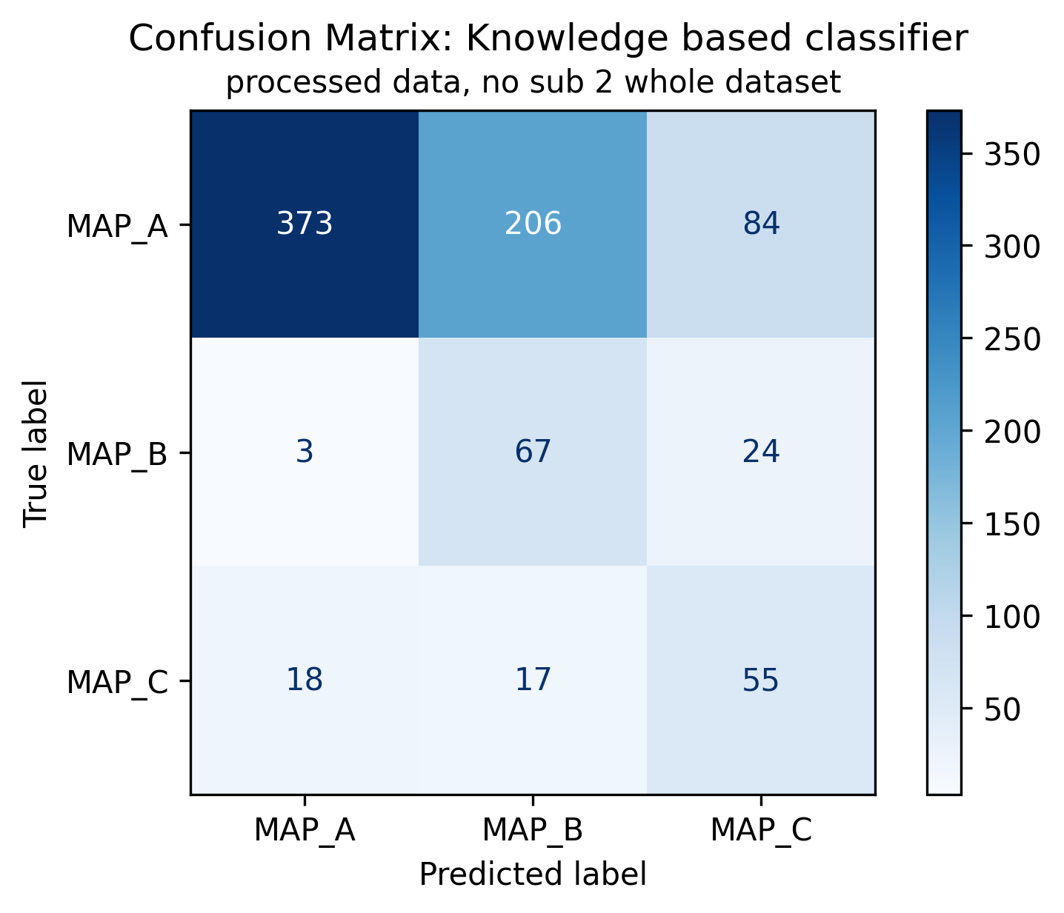
KB classifier V0 and V1: previous results
KB V1: atrial/ventricular ratio, th=0.5
KB V0: Atrial peak threshold
KB V1: atrial/ventricular ratio, th=0.5
Of 847 signals:
663 are ineffective (MAP A, 78.28%);
94 are effective (MAP B, 11.1%);
90 are dangerous (MAP C, 10.63%);

Slide 20
Outline
Feature extraction
Envelope features
Template matching features
Short time Fourier transformation features
Classification
Knowledge based classifier: recap
Improved Knowledge based classifier
Feature correlation analysis
Tree classifier: whole set of features and optimal subset of features
SVM classifier: whole set of features and optimal subset of features
MLR classifier: whole set of features and optimal subset of features
Best model evaluation
Conclusions

Slide 21
Knowledge based classifier with envelope-based features
For each roving trace, evaluate the corresponding (active areas) features. Then:
KB V2: peaks thresholds and position
KB V3: peaks thresholds and atrial/ventricular
Is Minor_peak >0.020?
No
Is Dominant_peak_time <0.49
No
Is Minor_peak >0.021?
No
Is atrial_ventricular_ratio >0.2?
No
MAP B
MAP B
Yes
Yes
Yes
Yes
MAP C
MAP A
MAP C
MAP A

Slide 22


Knowledge based classifier with envelope-based features
KB V2: peaks thresholds and position
KB V2: peaks thresholds and position
KB V3: peaks thresholds and atrial/ventricular ratio
Of 847 signals:
663 are ineffective (MAP A, 78.28%);
94 are effective (MAP B, 11.1%);
90 are dangerous (MAP C, 10.63%);

Slide 23
Knowledge based classifier: comparison V2 (improved) and V1 (original)
KB V2: peaks thresholds and position
KB V1: atrial/ventricular ratio, th=0.5
KB V2: peaks thresholds and position
Respect to KB V1:
Higher precision and less misclassified MAP C and MAP B signals
Increased number of misclassified signals from MAP C to MAP A and for MAP B to MAP A.
Of 847 signals:
663 are ineffective (MAP A, 78.28%);
94 are effective (MAP B, 11.1%);
90 are dangerous (MAP C, 10.63%);

Slide 24
Outline
Feature extraction
Envelope features
Template matching features
Short time Fourier transformation features
Classification
Knowledge based classifier: recap
Improved Knowledge based classifier
Feature correlation analysis
Tree classifier: whole set of features and optimal subset of features
SVM classifier: whole set of features and optimal subset of features
MLR classifier: whole set of features and optimal subset of features
Best model evaluation
Conclusions

Slide 25

Feature selection: correlation matrix
To avoid the usage of features correlated between each other, correlation matrix has been computed.
In the following, three blocks of features will be exanimated:
Envelope features
Template Matching features
STFT features

Slide 26

Correlation matrix: Envelope features
The following features have been discharged from analysis:
Dominant_peak_env
Dominant_peak_env_time
Subdominant_peak_env
Subdominant_peak_env_time
Minor_peak_env
Minor_peak_env_time
First_peak_env
First_peak_env_time
Second_peak_env
Second__peak_env_time
Third_peak_env
Third_peak_env_time
Dominant_peak
silent_phase
Directly correlated with signal peaks into active areas
Directly correlated with First Peak
Directly correlated with Silent Ratio

Slide 27

Correlation matrix: Template Matching features
The following features have been discharged from analysis:
cross_energy_TM1
cross_peak_TM2
cross_energy_TM2
Directly correlated with TM1 features

Slide 28

Correlation matrix: STFT features
The following features have been discharged from analysis:
Dominant_AvgPowMF
Subdominant_AvgPowLF
Subdominant_AvgPowMF
Minor_AvgPowLF
Minor_AvgPowMF
First_AvgPowMF
Second_AvgPowLF
Second_AvgPowMF
Third_AvgPowLF
Third_AvgPowMF
Directly correlated with other SFTF based features

Slide 29
Feature selection: conclusion
To avoid the usage of features correlated between each other, correlation matrix has been computed and some of:
Envelope features
Template Matching features
STFT features
Were excluded from the analysis
From an initial number of 59 features, a dataset of 31 features was obtained.

Slide 30
Outline
Feature extraction
Envelope features
Template matching features
Short time Fourier transformation features
Classification
Knowledge based classifier: recap
Improved Knowledge based classifier
Feature correlation analysis
Tree classifier: whole set of features and optimal subset of features
SVM classifier: whole set of features and optimal subset of features
MLR classifier: whole set of features and optimal subset of features
Best model evaluation
Conclusions

Slide 31


Machine learning approach: tree classifier
Machine learning approaches allow to model data with statistical models trained on a set of features.
Tree models are among the most easily explained, therefore the choice felt on them.
Mathematical rules are defined into each node to minimize the impurity of the following level
An “impurity measure” is required
Tuning the depth of the three is required
LOPOCV is used as validation technique
Tree classifiers
Tree 1: whole feature set
Tree 2: relevant feature set
Impurity measure: Cross entropy
Impurity measure: Cross entropy
Depth: maximising weighted f1 score
Depth: maximising weighted f1 score
Cross entropy definition
$$H\left(p\right)=−\sum_{i=1}^{N_{class}}{p_{i}\log\left(p_{i}\right)}$$
Weighted F1 score definition
$$F_{1, weighted}=\sum_{i=1}^{N_{class}}{w_{i}F_{1,i} } where w_{i}=\frac{\# samples class i}{\# total samples}$$

Slide 32


Tree classifier V1 – whole feature set: results
Tree 1: whole feature set
Of 847 signals:
663 are ineffective (MAP A, 78.28%);
94 are effective (MAP B, 11.1%);
90 are dangerous (MAP C, 10.63%);

Slide 33


Tree classifier V2 – subset of features: results
Tree 2: relevant features set
Of 847 signals:
663 are ineffective (MAP A, 78.28%);
94 are effective (MAP B, 11.1%);
90 are dangerous (MAP C, 10.63%);

Slide 34
Tree classifiers: LOPOCV confusion matrix comparison
Tree 1: whole feature set
Tree 2: relevant feature subset
Tree 2: relevant feature subset
Of 847 signals:
663 are ineffective (MAP A, 78.28%);
94 are effective (MAP B, 11.1%);
90 are dangerous (MAP C, 10.63%);

Slide 35



SHAP analysis on optimal feature subset

Slide 36
Outline
Feature extraction
Envelope features
Template matching features
Short time Fourier transformation features
Classification
Knowledge based classifier: recap
Improved Knowledge based classifier
Feature correlation analysis
Tree classifier: whole set of features and optimal subset of features
SVM classifier: whole set of features and optimal subset of features
MLR classifier: whole set of features and optimal subset of features
Best model evaluation
Conclusions

Slide 37

Machine learning approach: Support Vector Machines
Support Vector Machines (SVMs) are a powerful supervised learning method used for classification and regression tasks.
The key principle of SVMs is margin maximization: they aim to identify the hyperplane that has the largest margin (distance) to the nearest data points of any class, known as support vectors.
For complex datasets that are not linearly separable, SVMs employ the kernel trick, which maps the input features into a higher-dimensional space where linear separation is possible. Common kernels include linear, polynomial, and Gaussian.
These three kernels were compared in terms of performance, and the best one was used for model reduction.

Slide 38



SVM classifiers: results varying kernel type
SVM1: Linear Kernel
SVM1: Polynomial Kernel
SVM1: Gaussian Kernel
SVM1: Gaussian Kernel
Of 847 signals:
663 are ineffective (MAP A, 78.28%);
94 are effective (MAP B, 11.1%);
90 are dangerous (MAP C, 10.63%);

Slide 39

SVM classifiers: Gaussian kernel feature importance
SVM1: Gaussian Kernel
Of 847 signals:
663 are ineffective (MAP A, 78.28%);
94 are effective (MAP B, 11.1%);
90 are dangerous (MAP C, 10.63%);

Slide 40

SVM classifiers: LOPOCV confusion matrix comparison
SVM 1: whole feature set
SVM 2: relevant feature subset
SVM 2: relevant feature subset
Of 847 signals:
663 are ineffective (MAP A, 78.28%);
94 are effective (MAP B, 11.1%);
90 are dangerous (MAP C, 10.63%);

Slide 41
Outline
Feature extraction
Envelope features
Template matching features
Short time Fourier transformation features
Classification
Knowledge based classifier: recap
Improved Knowledge based classifier
Feature correlation analysis
Tree classifier: whole set of features and optimal subset of features
SVM classifier: whole set of features and optimal subset of features
MLR classifier: whole set of features and optimal subset of features
Best model evaluation
Conclusions

Slide 42



Machine learning approach: Multinomial logistic regression
Multinomial Logistic Regression (MLR) is a widely-used supervised learning method for multi-class classification problems.
The core concept of MLR is to model the probabilities of each class as a function of the input features using a softmax function, ensuring that the predicted probabilities sum to one.
Unlike binary logistic regression, MLR generalizes to handle more than two categories by estimating a separate set of coefficients for each class relative to a baseline.
MLR assumes a linear relationship between the input features and the log odds of the class probabilities, making it effective for linearly separable datasets.
$$P\left(y=C_{k} | x\right)=\frac{exp⁡(β_{k}^{T}x)}{\sum_{i=1}^{K}{exp⁡(β_{i}^{T}x)}}$$
$\log\left(\frac{P\left(y=C_{k} | x\right)}{P\left(y=K | x\right)}\right)=β_{k}^{T}x where K is the baseline$

Slide 43


GLM classifier V1 - whole feature set: results
MLR 1: whole feature set
Of 847 signals:
663 are ineffective (MAP A, 78.28%);
94 are effective (MAP B, 11.1%);
90 are dangerous (MAP C, 10.63%);

Slide 44


GLM classifier V2 – subset of features: results
MLR 2: relevant features set
Of 847 signals:
663 are ineffective (MAP A, 78.28%);
94 are effective (MAP B, 11.1%);
90 are dangerous (MAP C, 10.63%);

Slide 45
Tree classifiers: LOPOCV confusion matrix comparison
MLR 1: whole feature set
MLR 2: relevant feature subset
MLR 2: relevant feature subset
GLM classifier acts similarly to the improved knowledge-based classifier
Of 847 signals:
663 are ineffective (MAP A, 78.28%);
94 are effective (MAP B, 11.1%);
90 are dangerous (MAP C, 10.63%);

Slide 46
Outline
Feature extraction
Envelope features
Template matching features
Short time Fourier transformation features
Classification
Knowledge based classifier: recap
Improved Knowledge based classifier
Feature correlation analysis
Tree classifier: whole set of features and optimal subset of features
SVM classifier: whole set of features and optimal subset of features
MLR classifier: whole set of features and optimal subset of features
Best model evaluation
Conclusions

Slide 47




Best models comparison
KB V2: peaks thresholds and position
Tree 2: relevant feature subset
SVM 2: relevant feature subset
MLR 2: relevant feature subset

Slide 48
Take home messages
MLR 2: relevant feature subset
SVM 2: relevant feature subset
Take home messages:
GLM is the best classifier for effective signals (MAP B) and dangerous signals (MAP C), but:
higher misclassification of ineffective signals into effective ones
Higher misclassification of dangerous signals into ineffective (MAP A) ones
SVM reaches the highest weighted f1-score overall, comparing with the ne obtained from other similar studies (Baldazzi et al, 2023)

Slide 49
Outline
Feature extraction
Envelope features
Template matching features
Short time Fourier transformation features
Classification
Knowledge based classifier: recap
Improved Knowledge based classifier
Feature correlation analysis
Tree classifier: whole set of features and optimal subset of features
SVM classifier: whole set of features and optimal subset of features
MLR classifier: whole set of features and optimal subset of features
Best model evaluation
Conclusions

Slide 50
Conclusions
Three feature extraction pipelines based on envelope analysis, template matching and STFT have proposed:
Envelope features provides information on active areas of the signal
Template matching features provides information on signal morphology
STFT features provides information on average power across different frequency intervals and between active areas
Then, a total of 9 models have been evaluated:
An improved Knowledge based model based on envelope features
A decision tree (Leave One Patient Out Cross Validation) trained onto the whole feature set
A decision tree (LOPOCV) trained onto an optimized feature set
3 SVM models with different kernel (LOPOCV) definition onto the whole feature set
A gaussian kernel SVM (LOPOCV) onto an optimized feature set
Multinomial logistic regression (LOPOCV) trained onto the whole feature set
Multinomial logistic regression (LOPOCV) trained onto an optimized feature set
Results are encouraging, MLR model reaches the highest precision for MAP B and MAP C but has overall performances similar to the knowledge-based classifier . Gaussian kernel SVM model, defined onto a reduced set of feature, has the best overall performance, reaching a weighted f1-score of 0.82.
It has been shown that envelope-based features are the most relevant ones, confirmed by both the feature importance analysis and SHAP plots. Secondly, even Template matching features and STFT based ones plays a certain role into cases classification, with the TM ones more relevant then STFT ones, which are discharged by SVM models.

